Slide 1



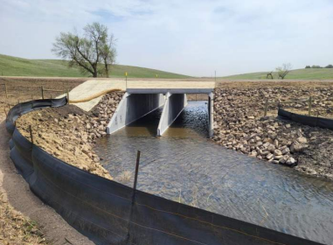
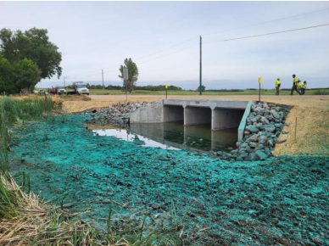
Davison County 5 Year Plan
2027 - 2031

Slide 2
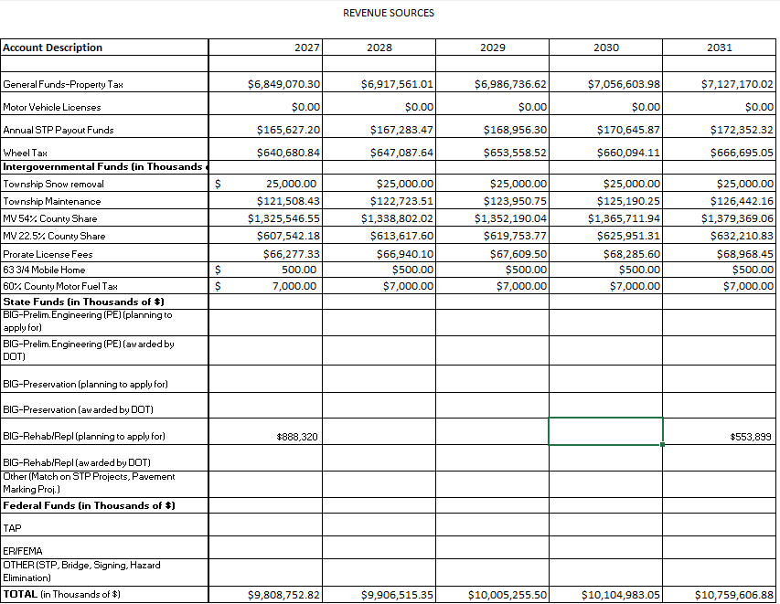

Slide 3
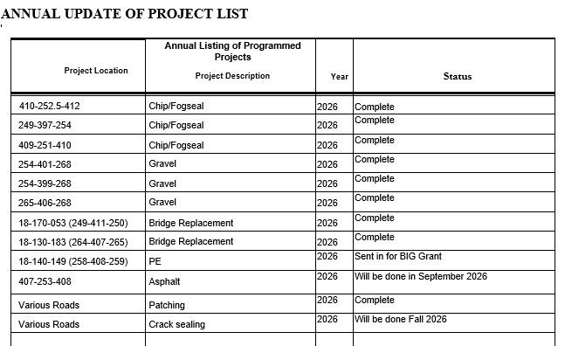

Slide 4
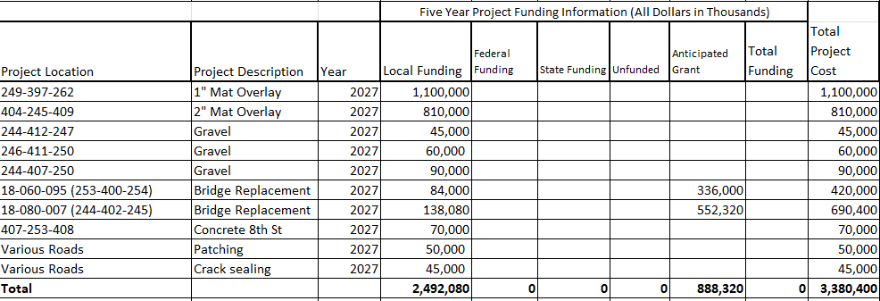

Slide 5
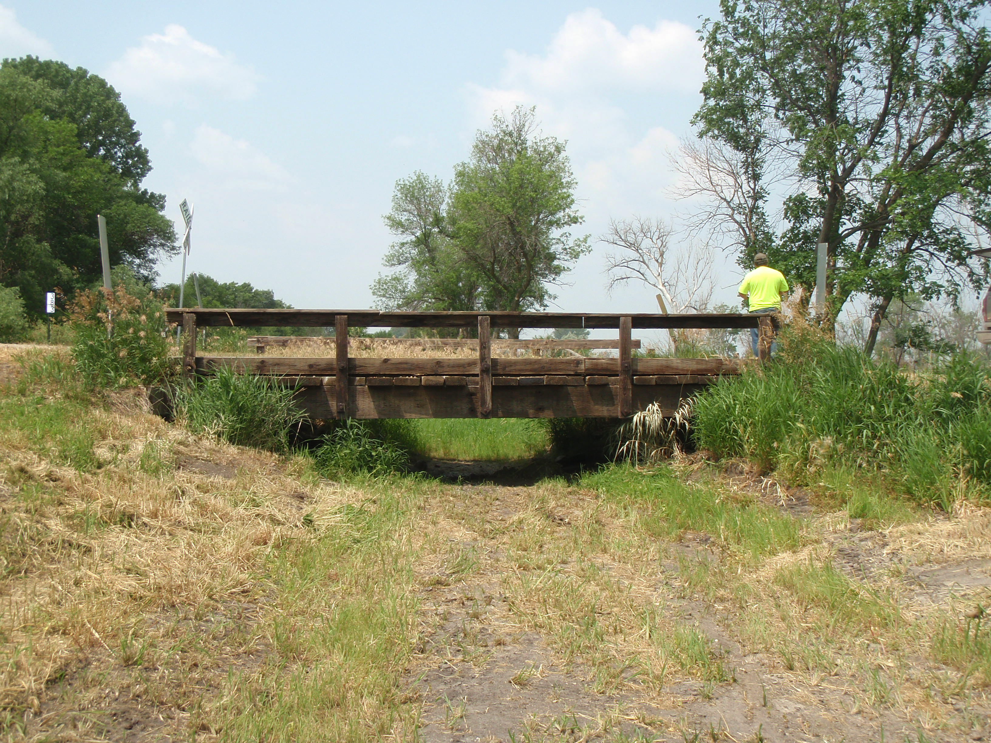
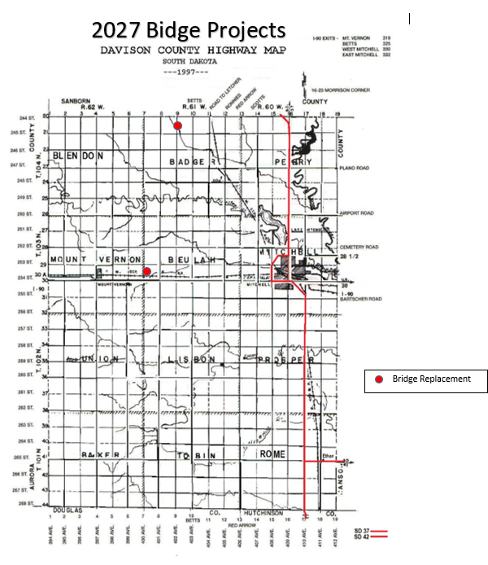
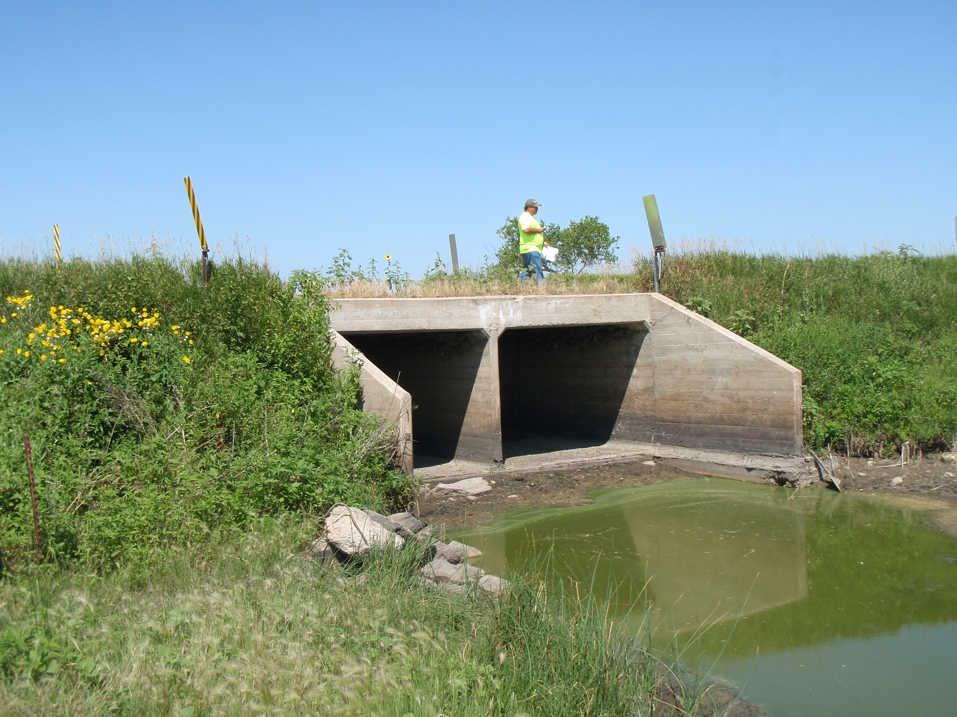
400th Ave b/t 253-254th St
402nd Ave b/t 244-245th St

Slide 6
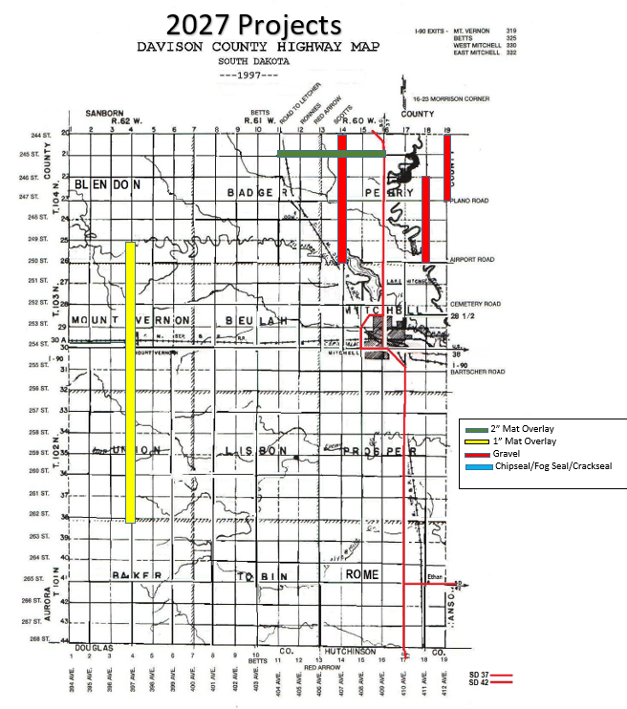
Gravel:
412th Ave b/t 244-247th St (3 miles)
411th Ave b/t 246-250th St (4 miles)
407th Ave b/t 244-250th St (6 miles)
Total miles = 13
1” Mat Overlay:
397th Ave b/t 249-262nd St
Total miles = 13
2” Mat Overlay:
245th St b/t 404-409th Ave
Total miles = 5

Slide 7
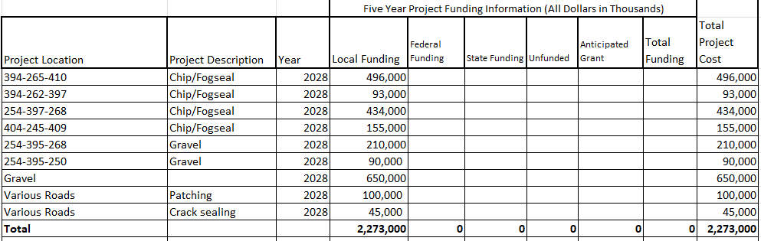

Slide 8
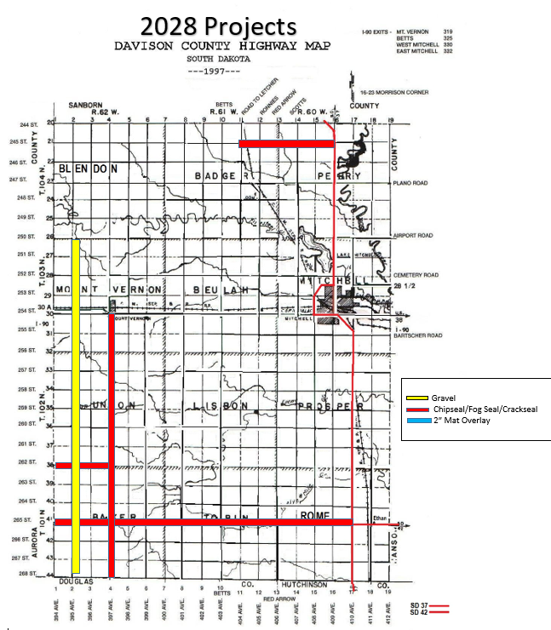
Chipseal/Fog seal:
265th St b/t 394-410th Ave (16 miles)
262nd St b/t 394-397th Ave (3 miles)
397th Ave b/t 254-268th St (14 miles)
245th St b/t 404-409th Ave (5 miles)
Total miles = 38
Gravel:
395th Ave b/t 254-268th St
395th Ave b/t 250-254th St
Total miles = 13

Slide 9
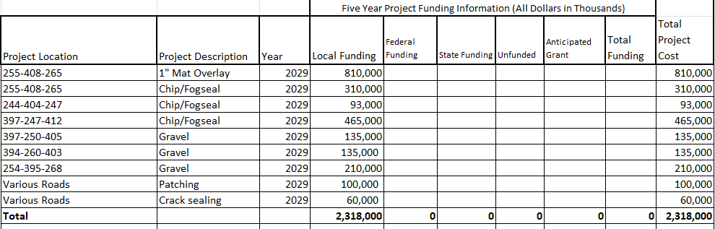

Slide 10
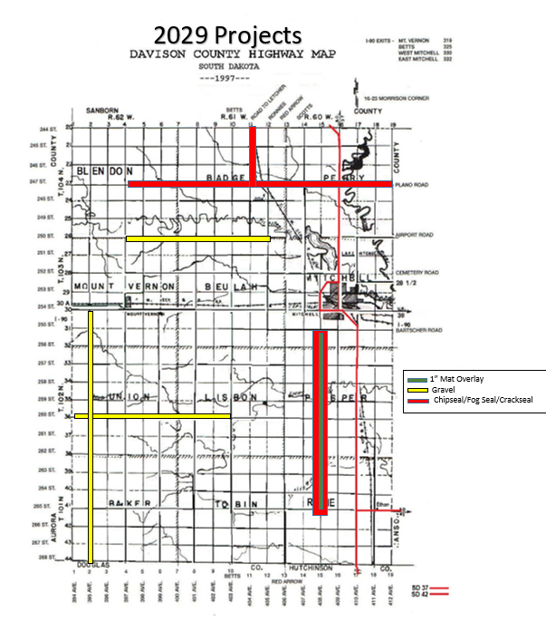
1” Mat Overlay:
408th Ave b/t 255-265th St (10 miles)
Total miles = 10
Chipseal/Fog seal:
408th Ave b/t 255-265th St (10 miles)
404th Ave b/t 244-247th St (3 miles)
247th St b/t 397-412th Ave (15 miles)
Total miles = 28
Gravel:
250th st b/t 397-405th Ave (8 miles)
260th st b/t 394-403rd Ave (9 miles)
395th Ave b/t 254-268th St (14 miles)
Total miles = 31

Slide 11
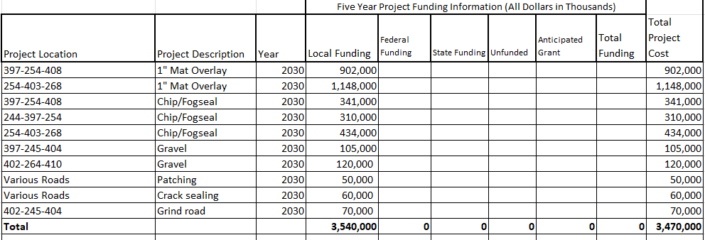

Slide 12
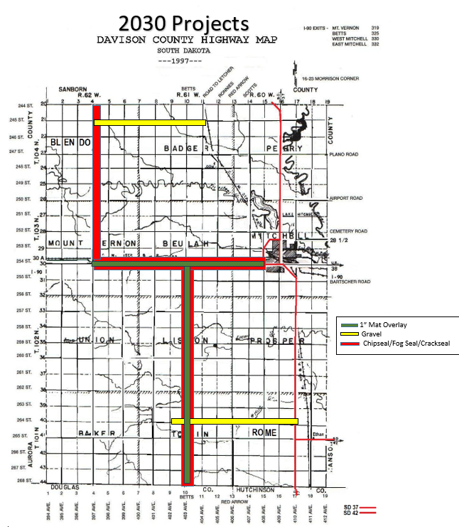
1” Mat Overlay:
254th St b/t 397-408th Ave (11 miles)
403rd Ave b/t 254-268th St (14 miles)
Total miles = 25
Chipseal/Fog seal:
254th St b/t 397-408th Ave (11 miles)
397th Ave b/t 244-254th St ( 10 miles)
403rd Ave b/t 254-268th St (14 miles)
Total miles = 35
Gravel:
245th St b/t 397-404th Ave (7 miles)
264th St b/t 402-410th Ave (8 miles)
Total miles = 15

Slide 13
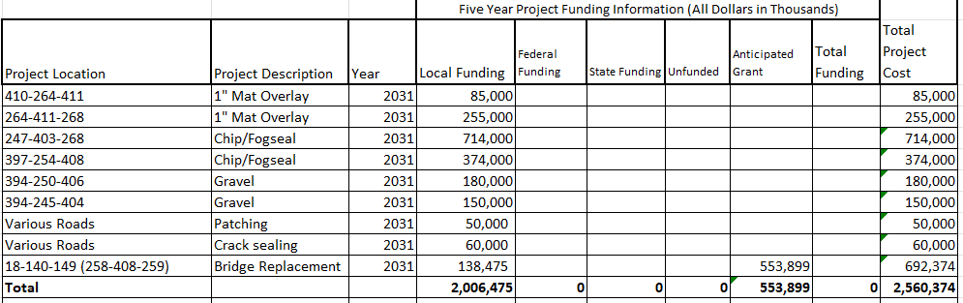

Slide 14
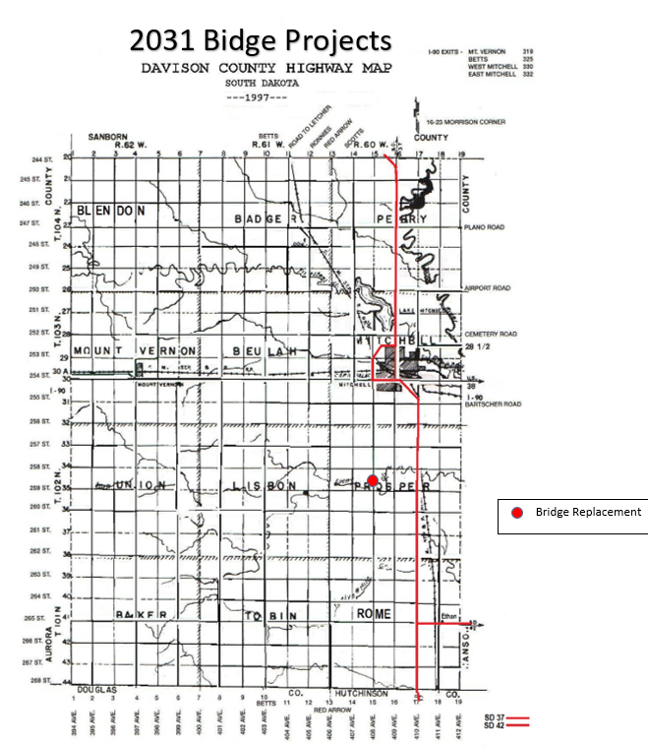
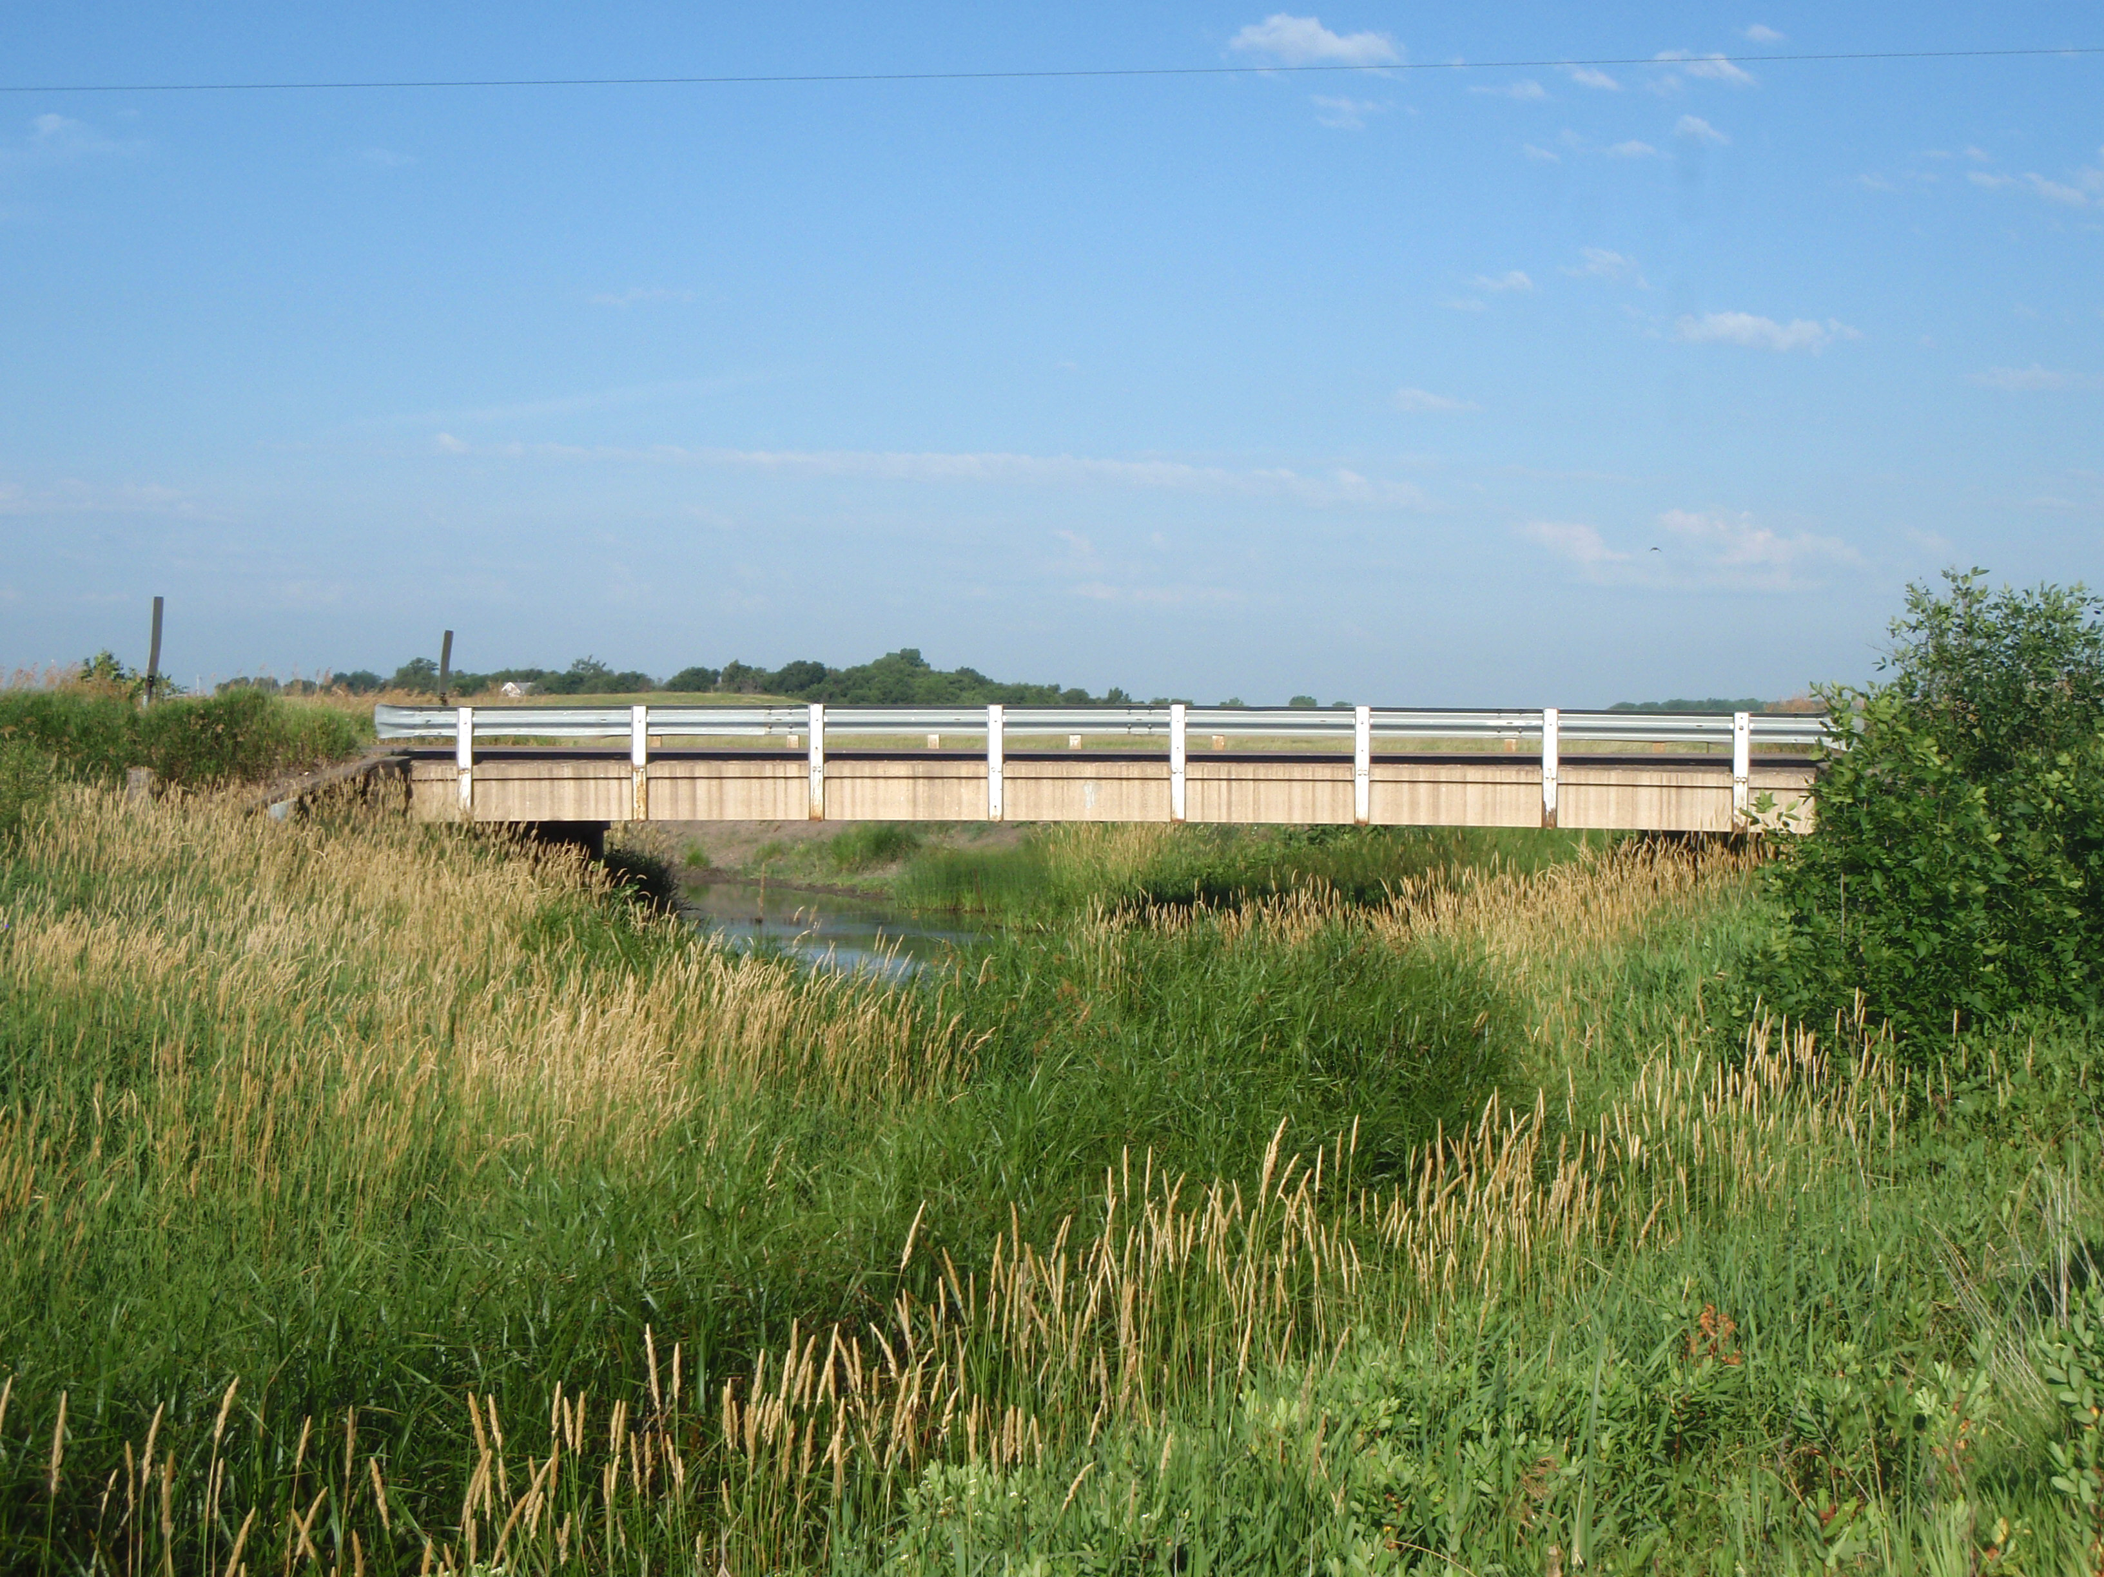
408th Ave b/t 258-259th St

Slide 15
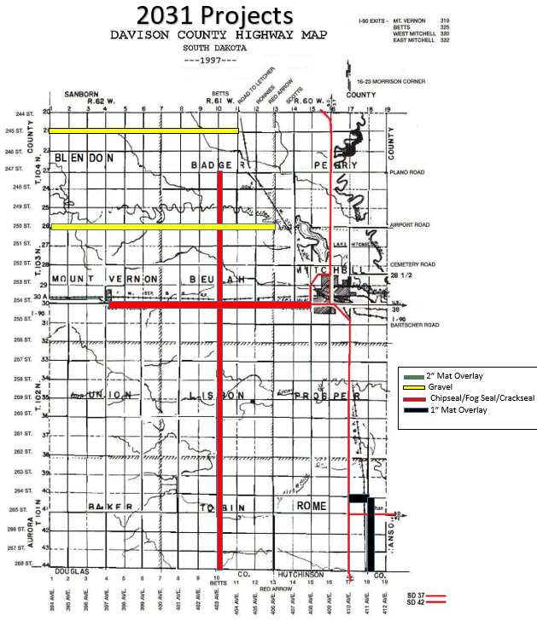
1” Mat Overlay:
264th St b/t 410-411th Ave (1 mile)
411th Ave b/t 264-268th St (4 miles)
Total miles = 5
Chipseal/Fog seal:
403rd Ave b/t 247-268th St (21 miles)
254th St b/t 397-408th Ave (11 miles)
Total miles = 32
Gravel:
250th St b/t 394-406th Ave (12 miles)
245th St b/t 394-404th Ave (10 miles)
Total miles = 22

