Slide 1
Project Overview
April 2024

Slide 3
Agenda
1
Project Overview
2
Economic Benefit
3
Landowner Compensation & Landowner Protections
4
Safety

Slide 4
OVERVIEW

Slide 5
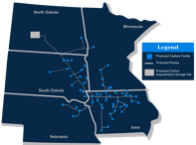
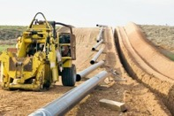
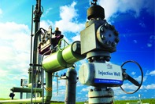
Midwest Carbon Express Overview
At our 57 partner ethanol plants, Summit Carbon Solutions will install new, state-of-the-art infrastructure
Carbon dioxide is captured that otherwise would be emitted into the atmosphere.
The captured greenhouse gases are compressed and moved through a newly constructed pipeline system.
CO₂ arrives at the injection site in North Dakota where it will be permanently and safely stored in deep underground geologic formations.
CO₂
Step 1
Step 2
Step 3

Slide 6
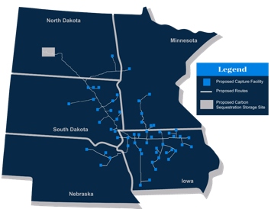
Project Location & Partner Facilities
57 BIOREFINERY PARTNERS ACROSS 22 COMPANIES
The Midwest Carbon Express will be located in five states and traverse 24 South Dakota counties.
OUR PARTNER PLANTS ARE EXPTECTED TO EARN AN ADDITIONAL
$.20+ PER GALLON
HISTORICALLY, PLANTS HAVE EARNED
$.10 TO $.15 PER GALLON.
ESSENTIALLY, THIS PIPELINE COULD
DOUBLE THE PROFITS OF OUR PLANTS PARTNERS.
8 PARTNERS & 15 FACILITIES LOCATED IN SOUTH DAKOTA
DAKOTA ETHANOL
GEVO
GLACIAL LAKES ENERGY
NUGEN ENERGY
REDFIELD ENERGY
RINGNECK ENERGY & FEED
POET
VALERO
BIOREFINERY PARTNER COMPANIES

Slide 7
Economic Benefit

Slide 8
Enhancing the Long-Term Profitability of Ethanol & Agriculture
SCS enables ethanol to be produced more sustainably allowing it to better compete in a low-carbon world
ETHANOL
ETHANOL AND AGRICULTURE WORK TOGETHER TO ADD VALUE ACROSS THE SUPPLY CHAIN AS WELL AS CREATE ECONOMIC IMPACT AND JOBS FOR RURAL AMERICA.
UNITED STATES
SOUTH DAKOTA
EACH YEAR, THE ETHANOL INDUSTRY ADDS:
$43B+
of annual GDP contribution
$3.3B+
of annual GDP contribution
EACH YEAR, THE ETHANOL INDUSTRY SUPPORTS:
350,000+
jobs
5,000+
jobs
THE LONG-TERM VIABILITY OF THE ETHANOL INDUSTRY IS CRITICAL FOR AGRICULTURE AND RURAL AMERICA
Source: Dakota Institute Research Document 2023

Slide 9
SCS Economic Benefits
SCS will drive economic growth and job creation across the Midwest and beyond
$8 Billion
$1.7 Billion
Capital Investment – Total Project
Capital Investment – South Dakota
CO₂
 | Capture & Compression | Pipeline | TOTAL
PROJECT JOBS | 132 – 198 | 14,067 – 17,193 128 – 156 | 14,199 – 17,391 348 - 463
OPERATION JOBS | 220 – 307
TOTAL JOBS 352 – 505 14,195 – 17,349 |  |  | 14,547 – 17,854
SUMMIT CARBON SOLUTIONS IS COMMITTED TO UTILIZING LOCAL UNION AND
NON-UNION CONTRACTORS, LOCAL SUPPLIERS, AND LOCAL BUSINESSES TO PROVIDE ONGOING ECONOMIC BENEFITS TO LOCAL COMMUNITIES ACROSS SOUTH DAKOTA AND THE MIDWEST.
Source: Ernst & Young 2023 Economic Impact Study, internal analysis
Operations jobs includes direct SCS employees, indirect, and induced
Jobs numbers do not include POET and Valero expansion

Slide 10
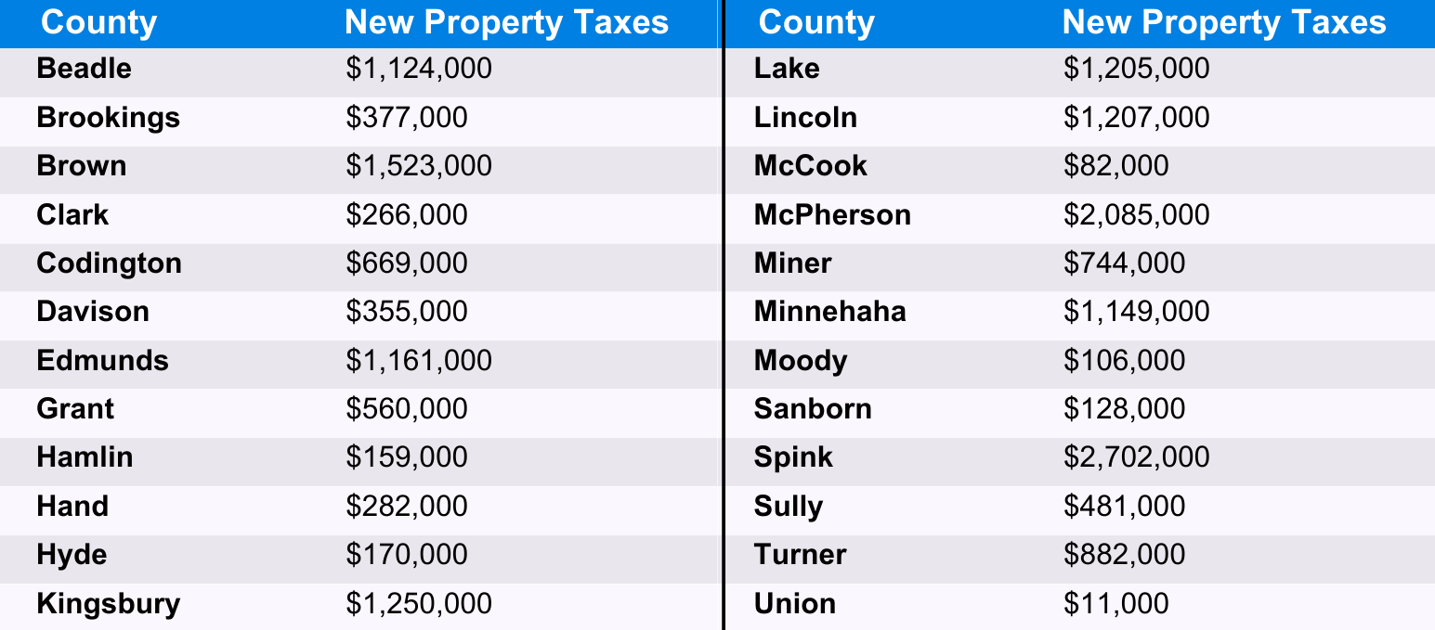
Tax Benefit Estimates

Slide 11
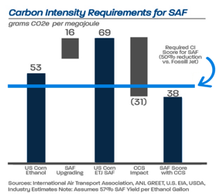
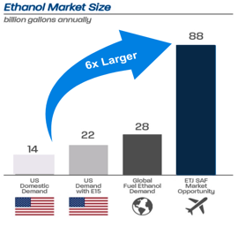
Sustainable Aviation Fuel Opportunity
Ethanol is projected to be the single largest feedstock for production of Sustainable Aviation Fuel (SAF)
What is Sustainable Aviation Fuel?
Ethanol-based sustainable aviation fuel (SAF) is used by airlines in their effort to become more carbon neutral. With limited alternatives to power today’s modern aircraft, SAF is expected to make up the majority of emissions reductions for the aviation industry. In 2022, global production of SAF amounted to just ~80 million gallons with additional capacity being planned around the globe to meet growing demand.
Growing Demand for SAF
Countries and companies around the world are planning to increase SAF usage, setting the stage for industry development and expansion. Corporate targets of SAF usage amount to 3.3 billion gallons annually by 2030. Governments are also incentivizing or requiring SAF usage through targets (U.S. – 3 billion gallons), mandates (EU, Japan) or various credits (Canada’s Clean Fuels program, state level low-carbon markets, state level tax incentives, Clean Fuel Production Credit – 45Z).
CCS is the most efficient way to produce low CI ethanol required for SAF production
SAF expected to add value to ethanol of at least $1.25 to $2.00 per gallon

Slide 12
Landowner Compensation & Landowner Protections

Slide 13

Compensation for Landowners
SUMMIT CARBON SOLUTIONS WILL HAVE LAND AGENTS ASSIGNED TO EACH INDIVIDUAL LANDOWNER FOR
THE DURATION OF THE PROJECT
WE ARE COMMITTED TO DEVELOPING AND MAINTAINING A POSITIVE, PRODUCTIVE RELATIONSHIP WITH LANDOWNERS BUILT ON TRUST AND TRANSPARENCY
CO₂
It’s a priority for Summit Carbon Solutions to negotiate easements with landowners that are agreeable for both parties and provide value to both parties
Easement rights are acquired with the land and are not impacted by future changes in ownership
Compensation is based on a fair market value for land in the county – Summit will be utilizing recent comparable sales data for each county to determine the fair market value. Compensation has 3 components: permanent easement, temporary easement, and damages
Summit Carbon Solutions will pay for anticipated damages to crops or lands prior to construction and work directly with landowners to address their specific concerns related to the impact of construction on their property.
FOLLOWING TODAY’S MEETING, WE WOULD LIKE TO HAVE THE OPPORTUNITY TO VISIT WITH LANDOWNERS INDIVIDUALLY, ANSWER QUESTIONS, AND HOPEFULLY SECURE YOUR PERMISSION TO START SURVEY WORK ON YOUR PROPERTY

Slide 14
Crop Loss Compensation
Summit Carbon Solutions will pay landowners for losses to crops planted prior to construction or if a crop normally would have been planted prior to the finish of construction
THE COMPANY WILL PAY FOLLOWING PERCENTAGES OF THE CROP LOST TO PRODUCTION:
100%
coverage of crop loss in the first year
80%
coverage of crop loss in the second year
60%
coverage of crop loss in the third year
Compensation will be paid prior to start of construction and based on the prevailing market price index by crop type or in accordance with any prearranged purchase agreements, and based upon the three-year annual average yield of the crop as documented by the landowner or by the records from the local agricultural agency
After the Midwest Carbon Express pipeline is placed into Operation, SCS will compensate landowners for crop yield deficiencies attributable to construction activity in the easement area for the life of the pipeline

Slide 15
Drainage Tile
Pipeline on the Midwest Carbon Express project will be buried at a minimum of four feet deep to the top of the pipe
EXAMPLES INCLUDE:
SCS will work with each landowner to develop a plan to restore drainage systems to its prior function
Individual drain tile repairs
Installation of new drain tile(s)
Redesign and re-installation of the drain tile system
WHO PERFORMS THE WORK?
As a common practice, SCS will employ a professional drain tile company to repair tile damaged during construction. We are also willing to work with landowners who prefer to hire their own contractor for the repairs
SCS will pay reasonable costs if the company chooses to have a representative present during this process
When practical, SCS will work with landowners to relocate tile(s) prior to the start of construction
SCS will warranty tile repair for the life of the pipeline

Slide 16
Safety

Slide 17
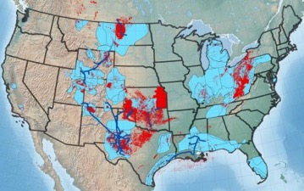
SCS: A Commitment to Safety
CCS technology has been safely and successfully implemented since the 1970s
CURRENT U.S. CO₂ PIPELINE FOOTPRINT
Capture technology has been deployed at 40+ ethanol facilities throughout the U.S.
CO₂ pipelines are regulated by the Pipeline Hazardous Material Safety Administration (PHMSA); same code that regulates crude oil pipelines, refined products pipelines, and other pipelines transporting liquid products
More than 5,300 miles of CO₂ pipelines are currently operating in the U.S.
Pipeline transportation is the safest method of transportation; 99.999% reliable
IMPECCABLE SAFETY RECORD
Zero
CO₂ pipeline fatalities in the last 25 years¹
SCS will only use high quality material and equipment and prefer material and equipment made or manufactured in the U.S. when available
SCS will utilize proven technologies and employ best industry practices to ensure the project is safe for landowners and the communities where they live, work, and raise families
CO₂ is much less of a health and environmental hazard than other pipelines. CO₂ is not combustible (it is used as a fire retardant)
[ 1 ] PHMSA

Slide 18
Thank You

