Slide 1
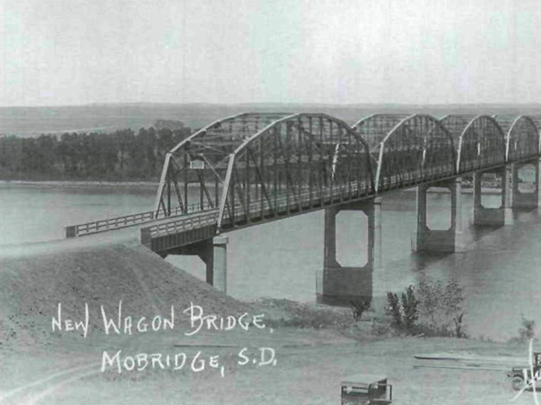
Davison County 5 Year Plan
2024 - 2028

Slide 5
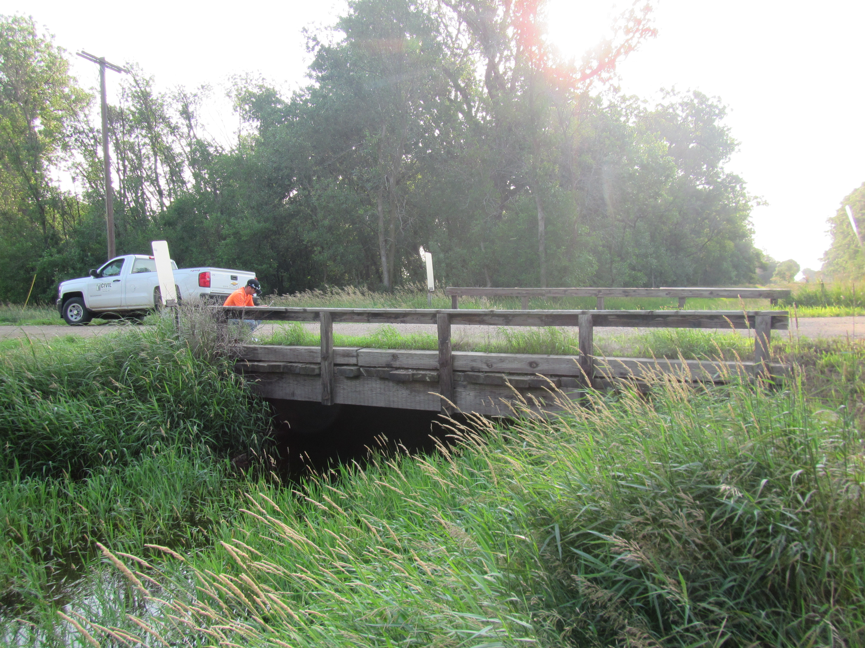
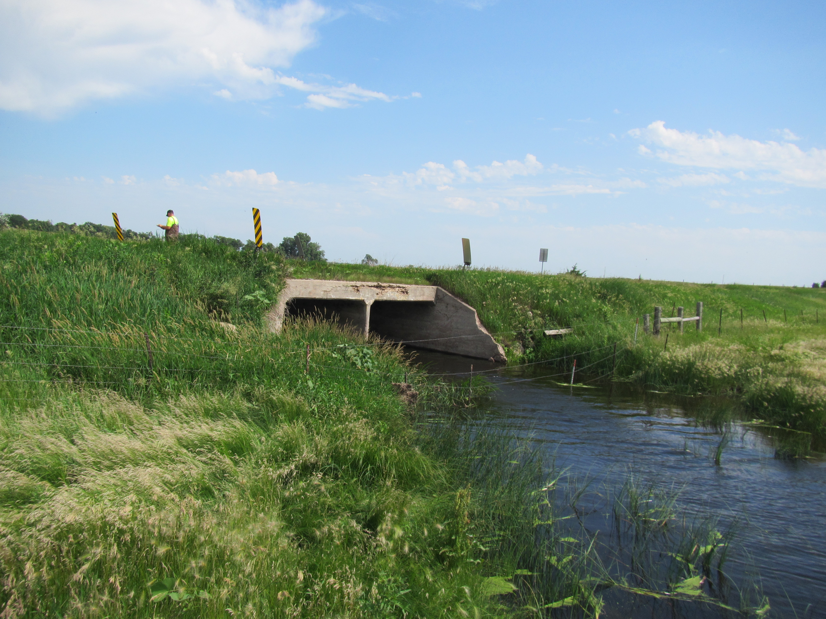
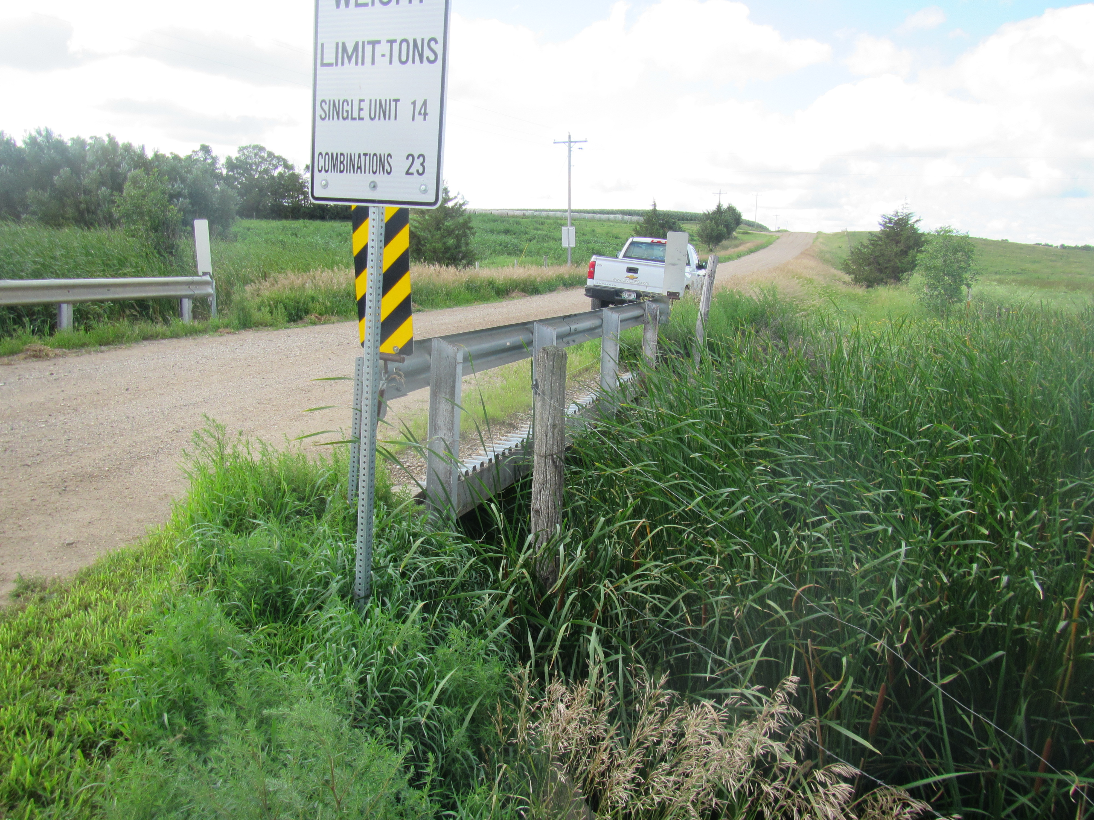
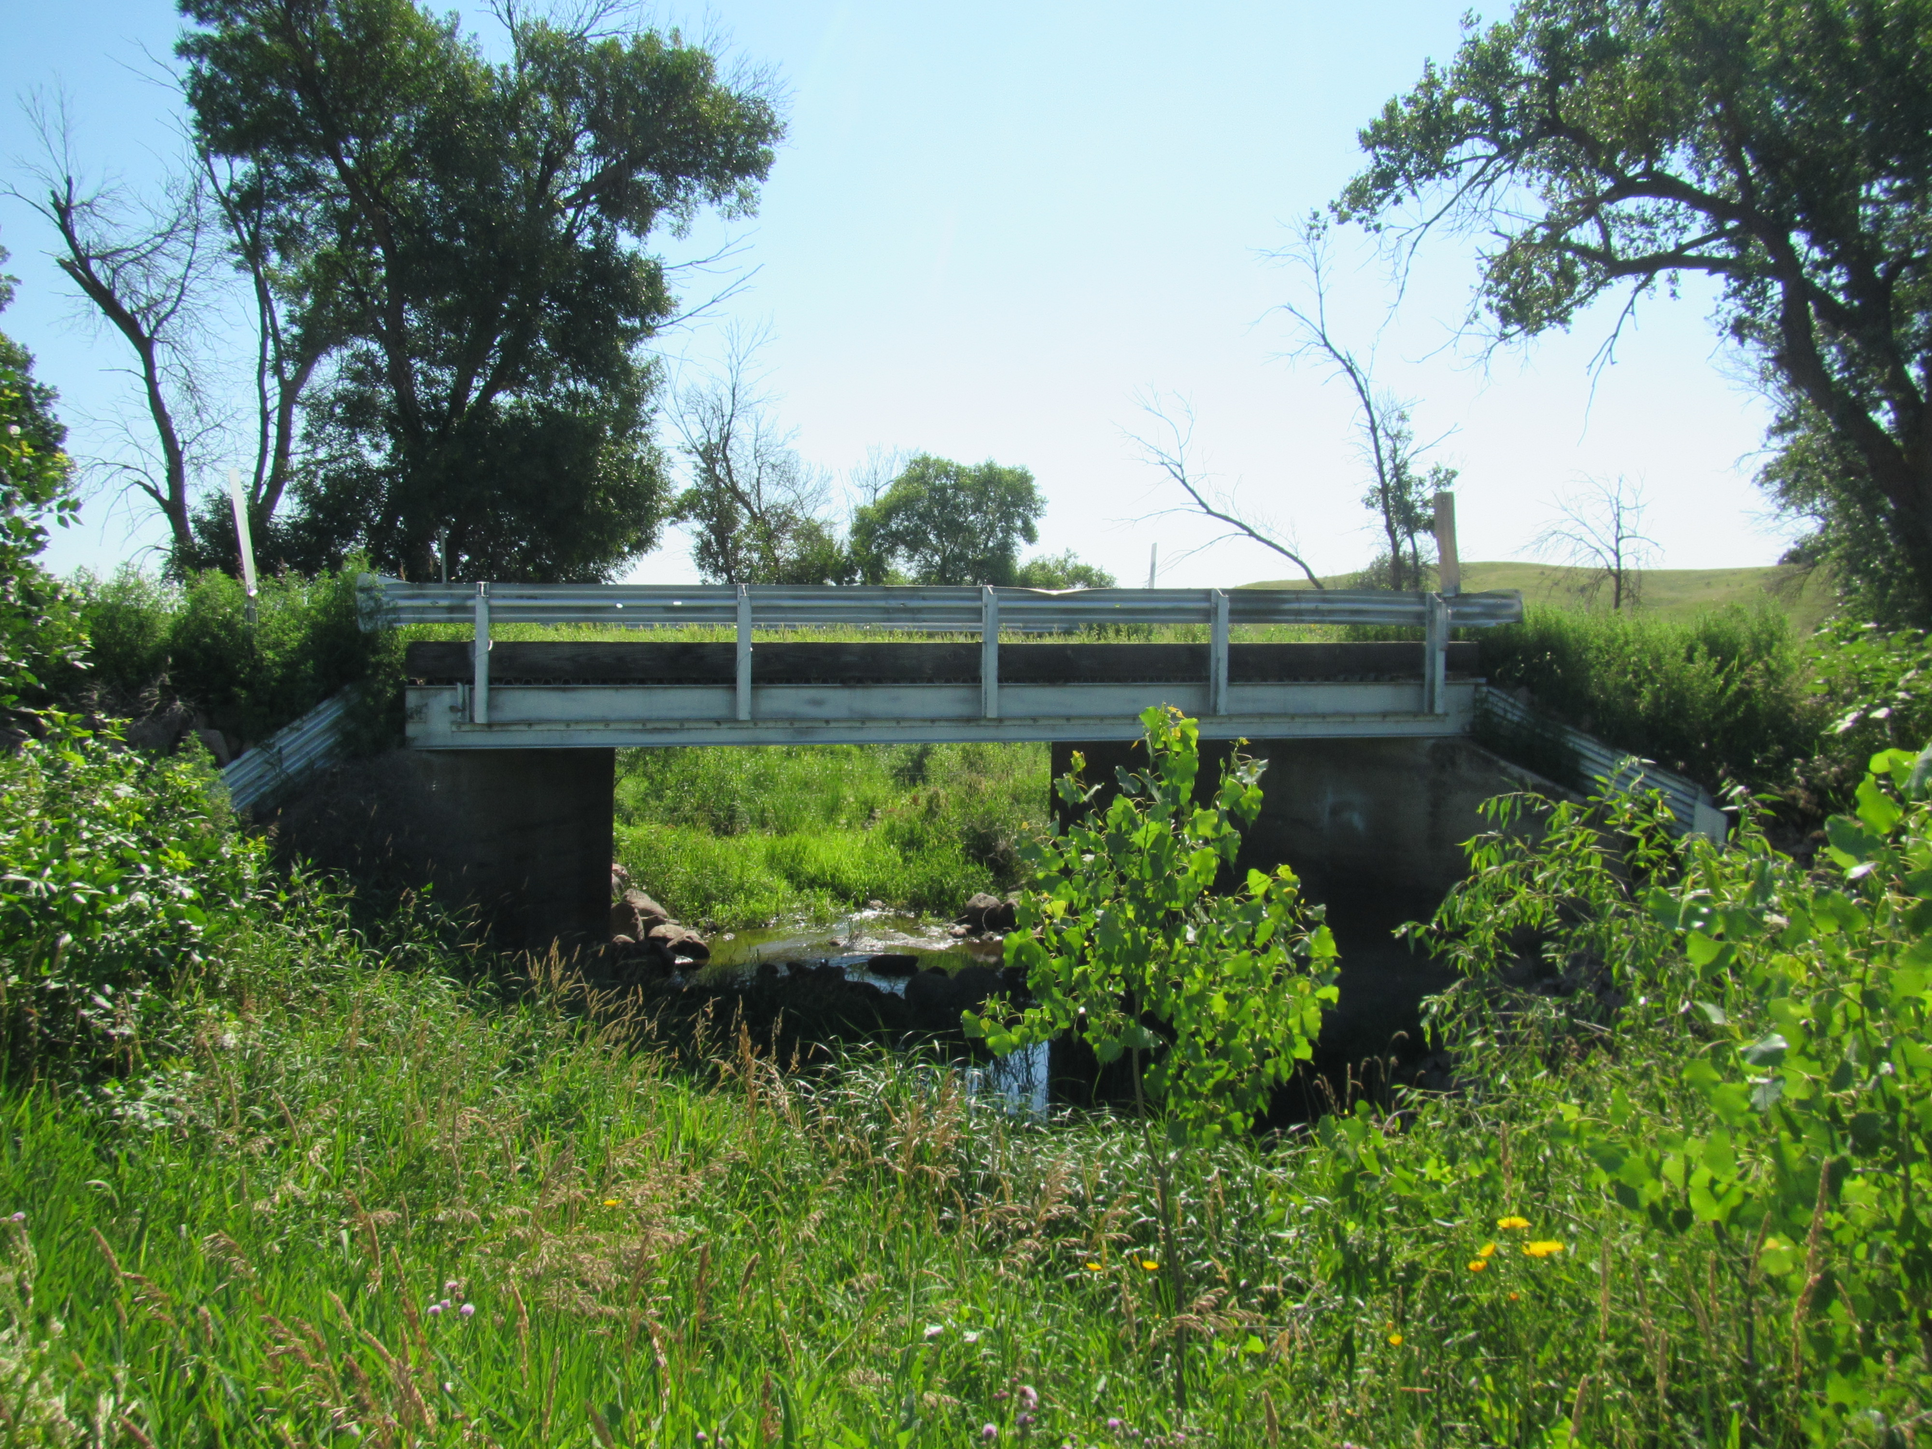
400th Ave b/t 253-254th St
402nd Ave b/t 244-245th St
407th Ave b/t 264-265th St
411th Ave b/t 249-250th St

Slide 6
Mat Overlay:
2” overlay: 407th Ave b/t 252-254 St (2 miles)
Total miles = 2
Chipseal/Fog seal:
407th Ave b/t 250-254 St (4 miles)
406th Ave b/t 254-265 St (11 miles)
411th Ave b/t 264-268 St (4 miles)
264th St b/t 410-412 Ave (2 miles)
265th St b/t 394-410 Ave (16 miles)
Total miles = 37
Gravel:
245th St b/t 394-402 Ave (8 miles)
250th St b/t 394-404 Ave (10 miles)
260 St b/t 394-403 Ave (9 miles)
Total miles = 27

Slide 8
Mat Overlay:
2” overlay: 245th St b/t 402-409 Ave (7 miles)
Total miles = 7
Chipseal/Fog seal:
405th Ave b/t 247-252 St (5 miles)
247th St b/t 397-409 Ave (12 miles)
409th Ave b/t 255-260 St (5 miles)
245th St b/t 402-409 Ave (7 miles)
Total miles = 29
Gravel:
245th St b/t 394-402nd Ave (8 miles)
395th Ave b/t 254-260 St (6 miles)
401st Ave b/t 254-260 St (6 miles)
Total miles = 20

Slide 10
Mat Overlay:
1” overlay: 397th Ave b/t 244-249 St (5 miles)
2” overlay: 397th Ave b/t 249-254.5 St (5.5 miles)
Total miles = 10.5
Chipseal/Fog seal:
252.5th St b/t 410-412 Ave (2 miles)
406th Ave b/t 254-265 St (11 miles)
397th Ave b/t 244-268 St (24 miles)
262nd St b/t 394-397 Ave (3 miles)
Total miles = 40
Gravel:
409th Ave b/t 260-265 St (5 miles)
268th St b/t 410-412 Ave (2 miles)
406th Ave b/t 265-268 St (3 miles)
Total miles = 10

Slide 12
Mat Overlay:
1” overlay: 252nd St b/t 398-408 Ave (10 miles)
1” overlay: 398th Ave b/t 252-253 St (1 mile)
1” overlay: 253rd St b/t 397.5-398 Ave (.5 miles)
1” overlay: 397th Ave b/t 254.5-268 St (13.5 miles)
1” overlay: 254th St b/t 397-408 Ave (11 miles)
Total miles = 36
Chipseal/Fog seal:
254th St b/t 397-408th Ave (11 miles)
252nd St b/t 398-408th Ave (10 miles)
398th Ave b/t 252-253rd St (1 mile)
253rd St b/t 397.5-398th Ave (.5 mile)
397th Ave b/t 254.5-268th St (13.5 miles)
Total miles = 36
Gravel:
412th Ave b/t 244-247th St (3 miles)
411th Ave b/t 246-250th St (4 miles)
407th Ave b/t 244-250th St (6 miles)
Total miles = 13

Slide 14
Mat Overlay:
1” overlay: 265th St b/t 394-410 Ave (16 miles)
1” overlay: 397th Ave b/t 249-254 St (5 miles)
Total miles = 21
Chipseal/Fog seal:
265th St b/t 394-410th Ave (16 miles)
262nd St b/t 394-397th Ave (3 miles)
397th Ave b/t 254-268 St (14 miles)
245th St b/t 402-409 Ave (7 miles)
Total miles = 40
Gravel:
395th Ave b/t 254-268 St (14 miles)
395th Ave b/t 254-250 St (4 miles)
247th St b/t 394-397th Ave (3 miles)
Total miles = 21

