Slide 1
Davison County Planning & Zoning
Jeff Bathke Director jeffb@davisoncounty.org
605-995-8615 or 605-995-8640
© 605-999-2863

Slide 2
High Plains Processing, LLC
Soybean and Sunflower (40% oil) Switch Plant
SE corner of HWY 37 & 257th (296 Acres)
BNSF, Power, Gas, Water, Wastewater, Access
Safety-Service-Sanitation
Vegetable oil (replace stock of vegetable oil used for renewable diesel) and Feedstock.
Why Davison County? Ag friendly community, an ideal site, a willing seller, proximity to other plants.

Slide 3
Groundbreaking Ceremony
September 19th at the site, presentation by Governor Noem.
Several other dignitaries in attendance.
$505 Million facility.
Goal was to raise $25 Million in local investment. Actual amount raised was over $80 Million.
Partner with British Petroleum (BP), who is a major investor.
Two-Year Construction will have a major ripple effect on Davison County and the surrounding area.
Operating Plant will add jobs, bring in new residents, more students in schools, and generate many tax dollars.

Slide 4
Grants/Incentives
Davison County approved a $21 Million dollar Tax Increment Financing District for the area, which will use the property tax generated to improve infrastructure on site.
Davison County was approved for a $162,250 DOT Grant to build a northbound turning lane on 257th ST.
Davison County is working on an $17 Million dollar loan to assist in the construction of the rail line on the property. This will be a 2% loan from the State Rail Trust Fund.

Slide 5
Permit Process
Application for a Conditional Use Permit in the AG District
Notifications (100 Owners/115 Properties)
Ag Use Covenants
Public Hearing-Planning Commission
Public Hearing-Board of Adjustment
Building Permit-50 Structures. Permit Fee was $98,439.

Slide 6
Traffic Impact Study Comments
HWY 37/Spruce-minor changes to light timing and extended east turning lane.
HWY 37/257th-Turning Lanes
4,716 Average Daily Traffic (ADT) (434 are trucks)
Plant will add 436 ADT (9% increase). Some may be overlap of existing traffic.
Peak Harvest will see 565 ADT truck traffic (12% increase)
BNSF, Davison County, Prosper Township, and the SD DOT approved the Traffic Study and improvements recommended by Short Elliot Hendrickson Inc.

Slide 7
Traffic Impact Study Comments
The plant has the ability to hold 64 double trailers on site.
A single truck is 67’ long and can hold 970 bushels.
A double truck is 100’ long and can hold 1,550 bushels.
It is anticipated that 82% of the trucks will be single trailers and 18% doubles.
The plant can process 50,000 bushels per hour.
2025-Expected 127 Trucks per day.
2030-Expected 176 Trucks per day, with peak harvest of 565 Trucks per day.

Slide 8
Rail Traffic
The Plant will generate 638 railcars of product per month.
The RR intersection at 257th currently sees an average of 2 trains per day.
Two unit trains (single commodity) and 3 manifest trains (accept cars from multiple locations) per week are expected for the plant (57% increase).
A unit train will take approximately 5 minutes 30 seconds to clear Spruce St. at 15 MPH.
At worse-case scenario, a train will block 257th St. for 20 minutes.
Using worse-case scenario data, the HWY 37 southbound left turn lane at 257th is recommended to be extended from 221’ to 1,250’.
Using worse-case scenario data, the HWY 37 northbound right turn lane at 257th is recommended to be extended from 0’ to 1,100’.
The RR Tracks (both sides) will include a “Do Not Block Tracks” sign.
If the RR Tracks are blocked by a train entering/exiting the plant, there is sufficient room to store trucks in the southbound and northbound turning lanes that will be installed on HWY 37.

Slide 9
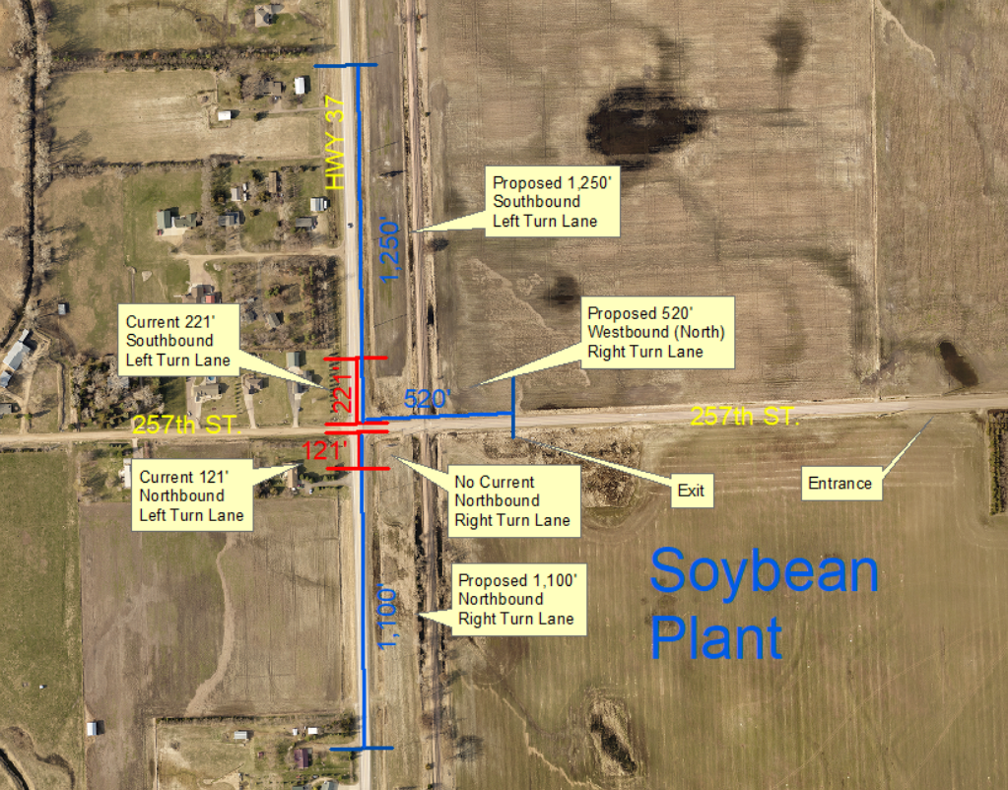
Traffic Impact Study Recommendations

Slide 10
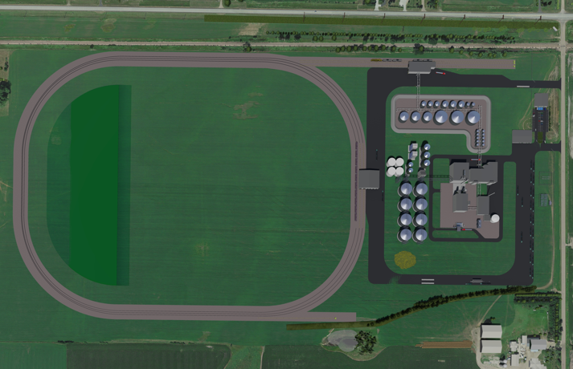
Proposed Layout
HWY 37
BNSF Mainline
257th St.
Oil Loadout
Oil Storage
Beans/seed will be brought in via truck and stored in grain storage.
Beans/seed enters the crush process at prep, into extraction where meal and oil are separated and sent to meal or oil storage (or refining and then storage) where it will be shipped out via rail or truck.
Meal Storage
Prep
Meal Loadout
Refinery
Bean/Seed Receiving
Bean/Seed Storage
Extraction
Truck Flow

Slide 11
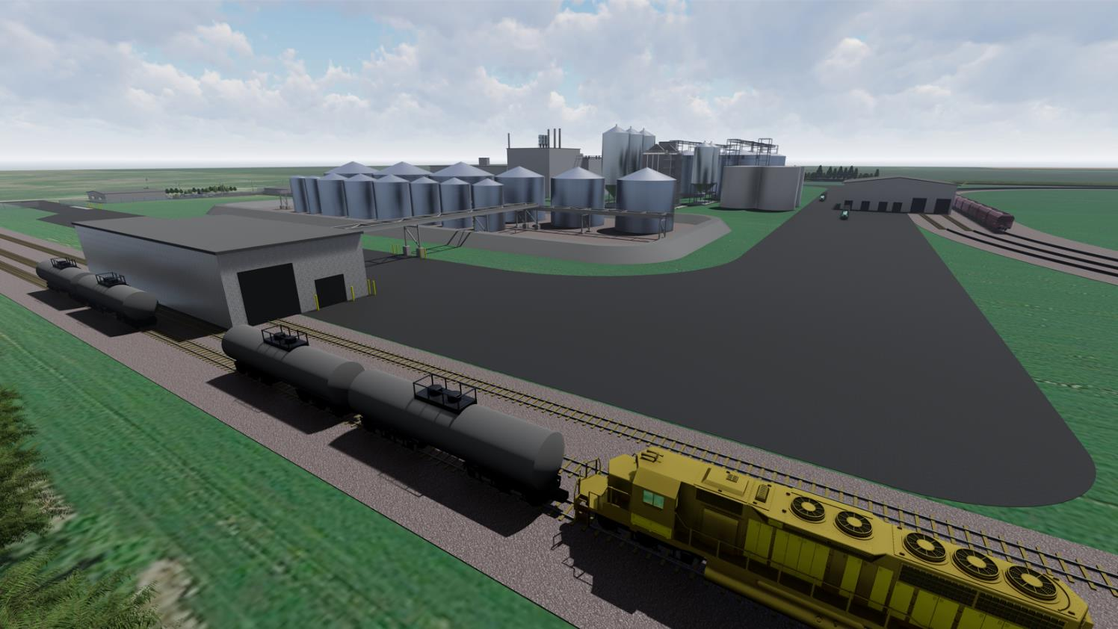
3D Plant Site Renderings (Northeast View)

Slide 12
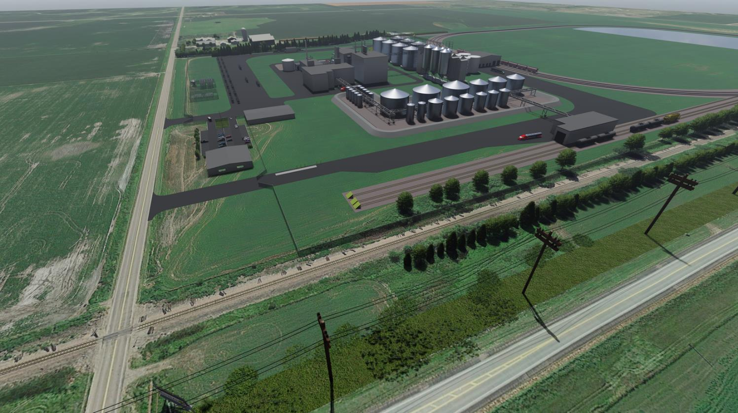
3D Plant Site Renderings (East View)

Slide 13
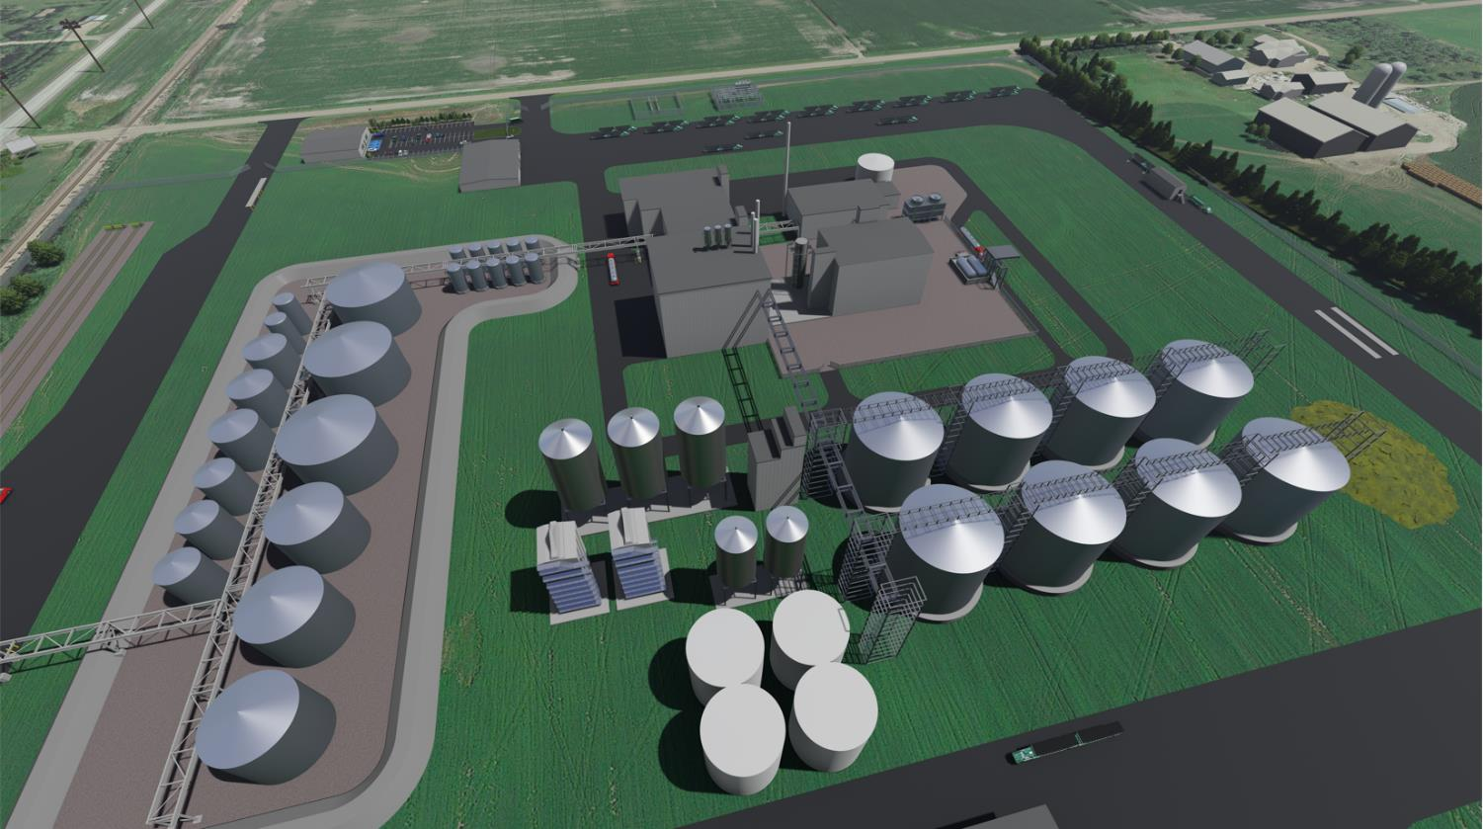
3D Plant Site Renderings (Aerial View)

Slide 14
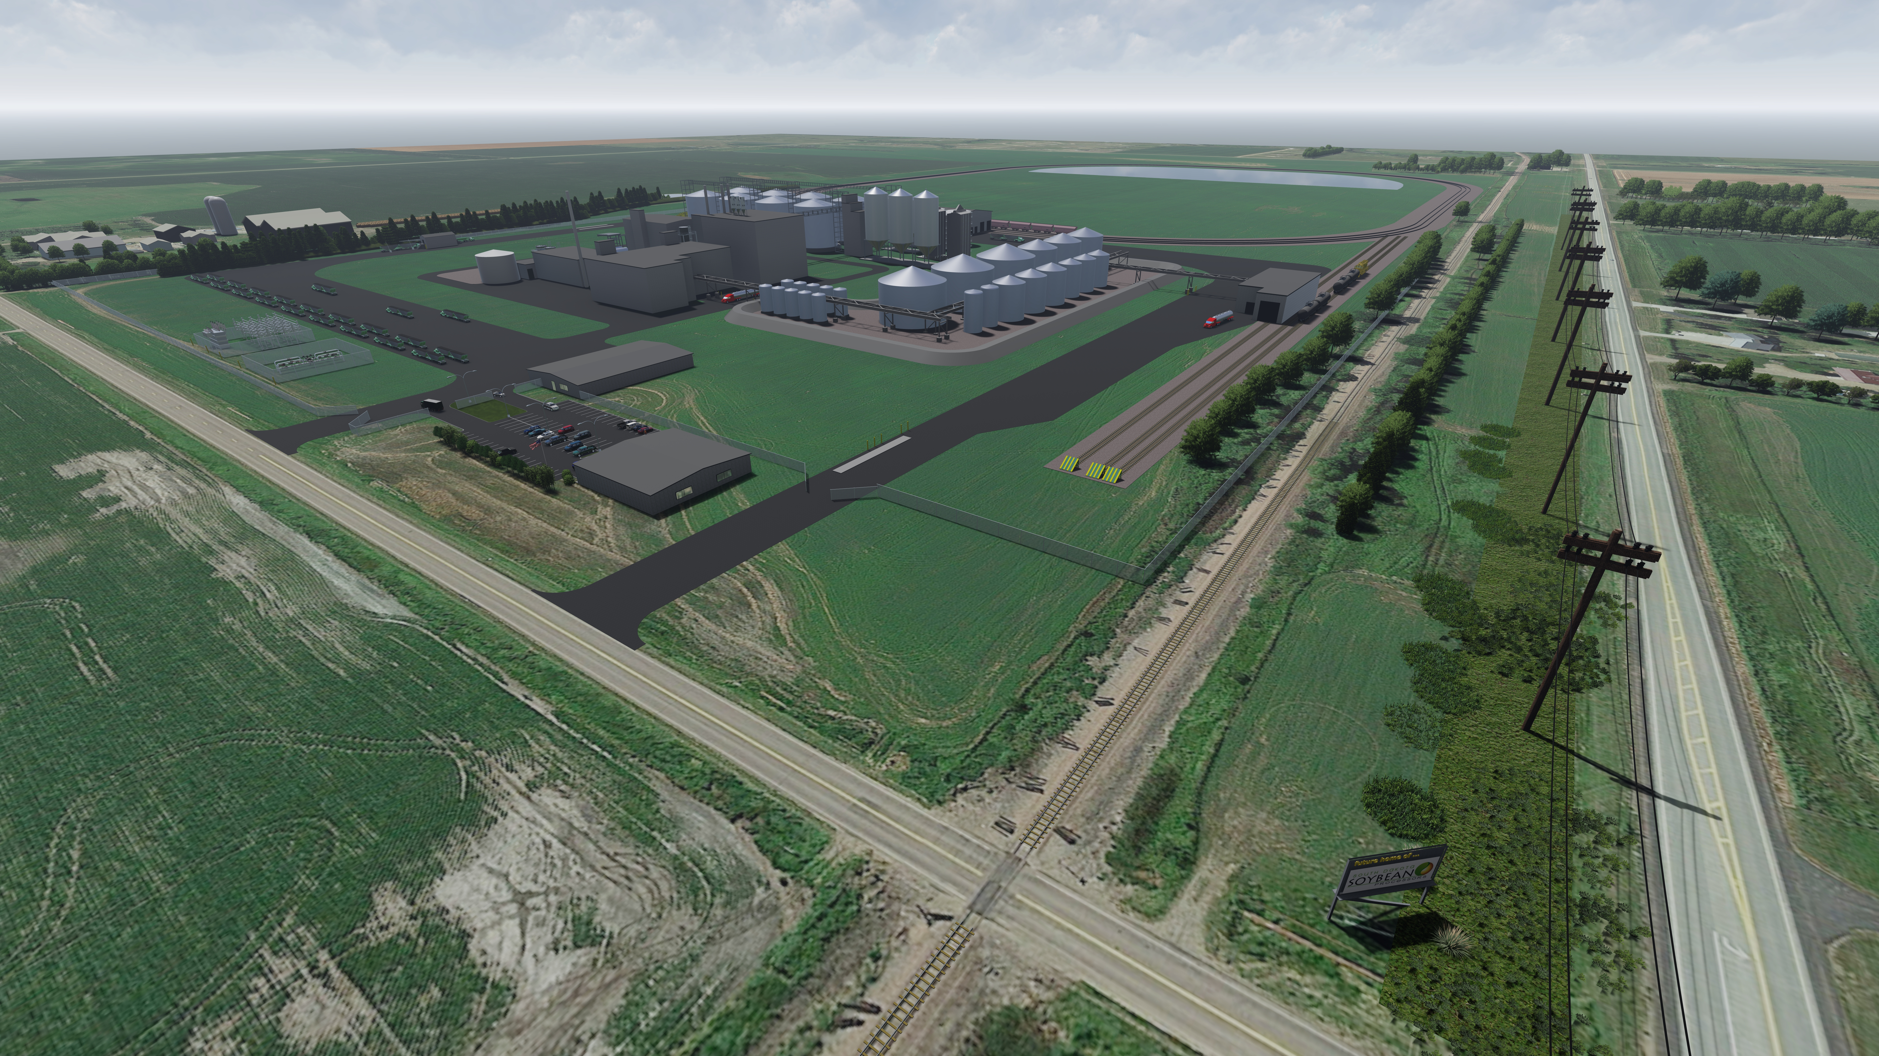
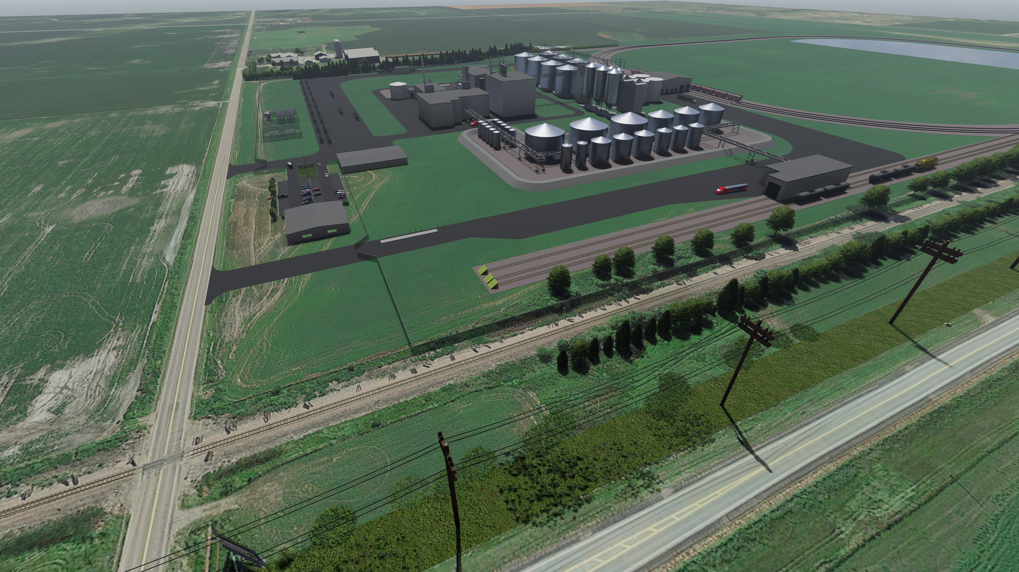
Proposed SDSP Plant – Mitchell, SD
Project Specifications
Water | 460,000-530,000 GPD
Wastewater | 85-90 GPM est.
Power | 6.0 – 6.5 MW 5,000 – 6,700 kW total demand
Natural Gas | 3,000 MMBtu/day
Bu. Commodities/Year | 35,000,000 bu. at 100% soy crush 850,000 tons – high oilseed crops at 100% crush
CapEx Numbers | $504,000,000
Employees | 85 FTEs Competitive Wages Full Benefit Packages
Notes:
Metric Million British Thermal Unit

Slide 15
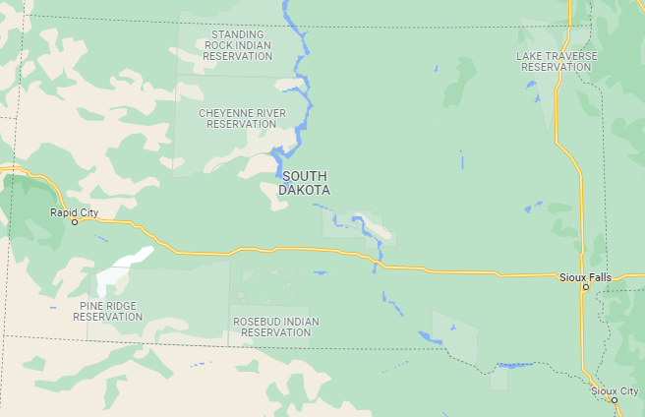
Proposed SDSP Plant – Mitchell, SD
85 Full-Time Employees
Estimated $4.25+ Million in Annual Salaries
Indirect benefits, including but not limited to grocery purchases, restaurant services, housing, utilities, health care, increased tax revenue, etc.
Utilization of Local Providers across the board
State Sales Tax, City Sales Tax & Contractors Excise Tax Revenue
High demand for locally produced grains
Positively impacting basis for farmers
Site & Switch Facility Profile
Location | Mitchell, SD
Site Acreage | 296+/- (under option)
Logistics Infrastructure | Adjacent to BNSF Railway Mainline
Estimated Labor | 85 Full-Time Employees
Project Highlights
Plant Start Date | Fall 2025
Crush Capacity (TPD) | Soybean – 3,000 Sunflower – 2,400
Estimated Annual Volumes (Tons) | Meal – 569,625 Oil – 298,725
Storage Volumes | Beans/Seed – 4M bu. Meal/Hulls – 8,000 MT Crude Oil – 12.3M Gal. Refined Oil – 3.52M Gal.
SDSP Switch Plant
Mitchell, SD

Slide 16
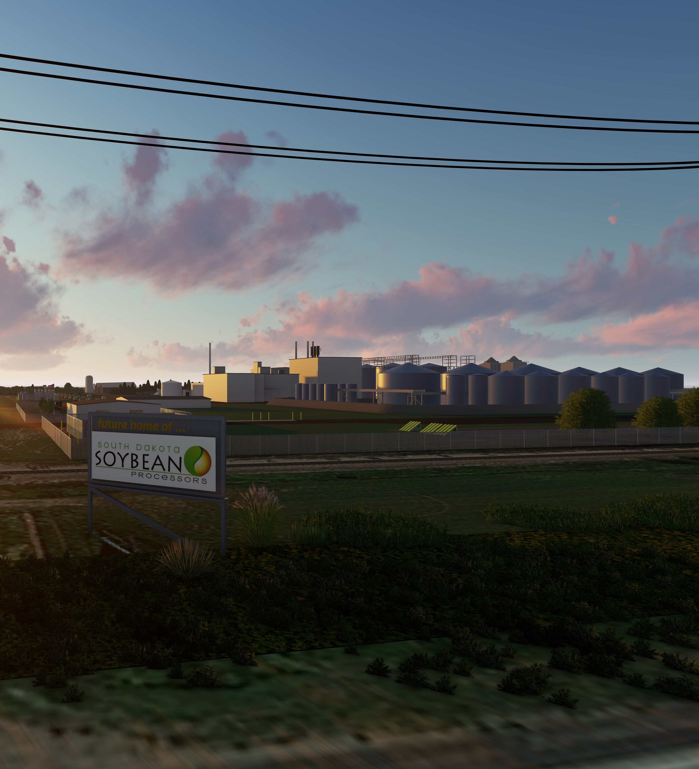
Project Timeline
Site Development/Utility Due Diligence/County Permitting
July 2022
Engineering/Project Development
Summer 2023
Equipment Procurement
Fall 2022-Summer 2024
Construction/Build Out
Fall 2023-Summer 2025
Plant Commissioning
Summer/Fall 2025

Slide 17
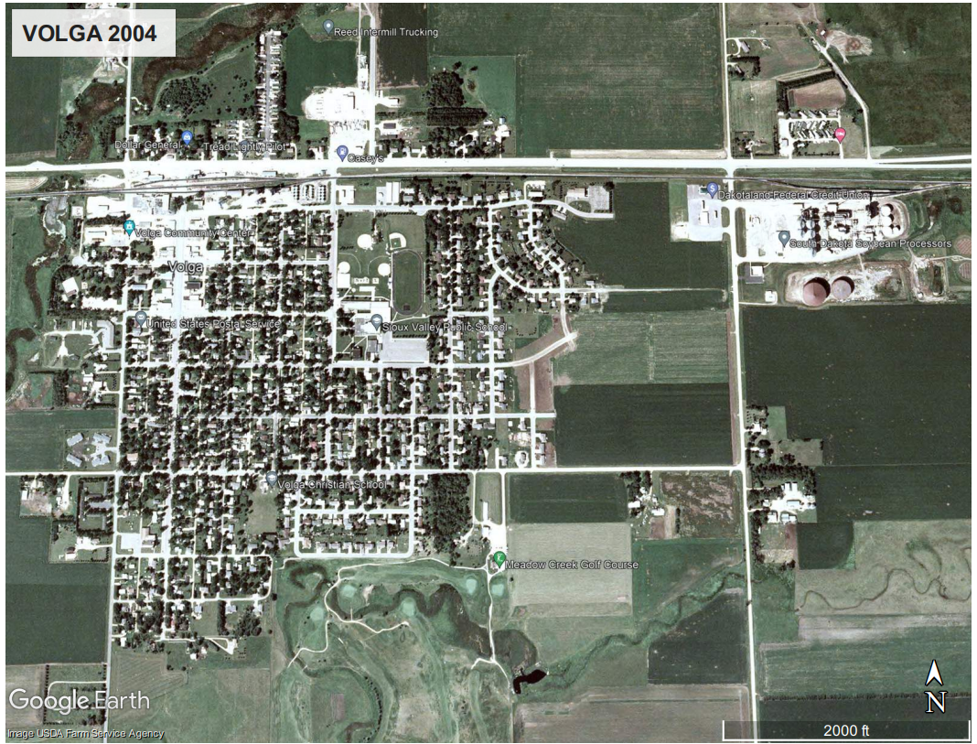
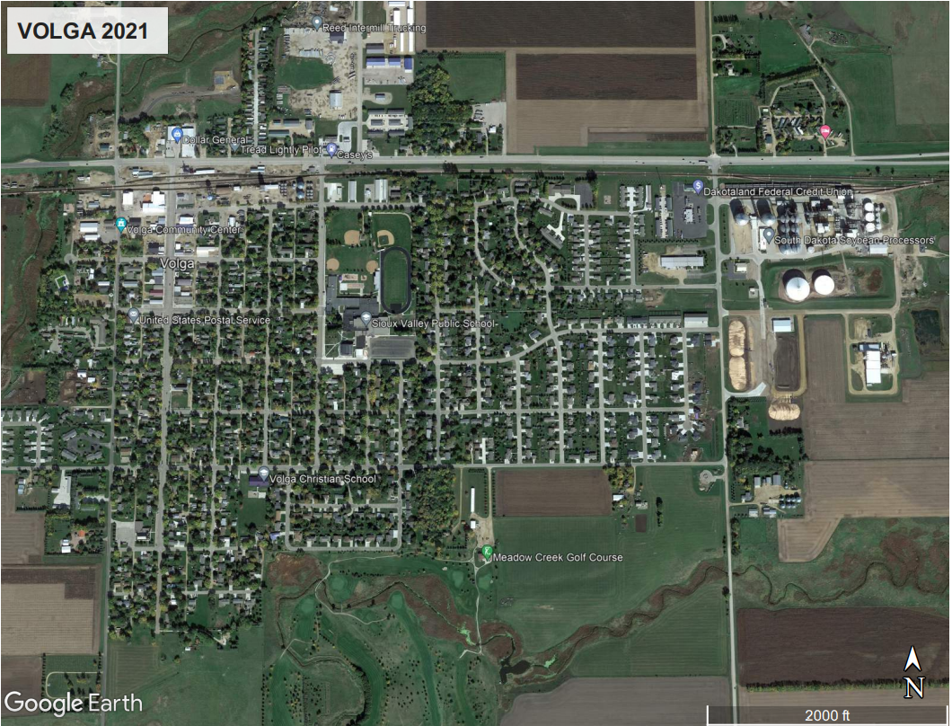
Volga Plant: 2004 vs. 2021

Slide 18
Project Team Members
South Dakota Soybean Processors
KFI Engineers - Project Design
Ascendant Partners - Project Financing
A1 Development Solutions - Project Development

