Slide 1
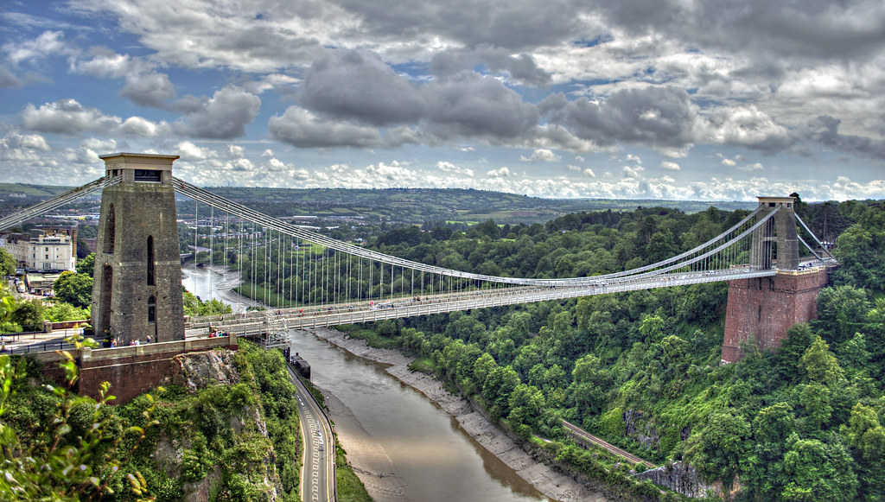
Davison County 5 Year Plan
2022 - 2026

Slide 2
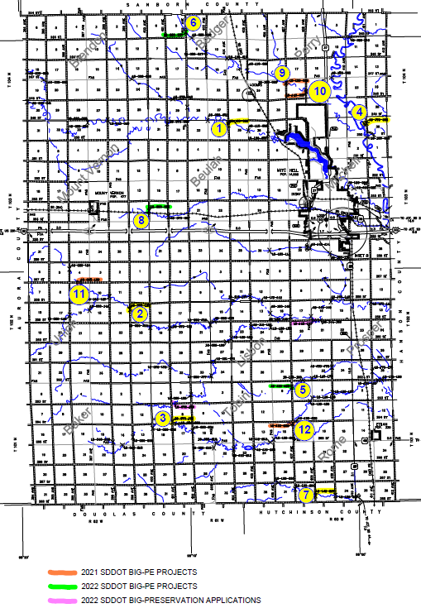
1: 18-100-052 (404th Ave b/t 249-250)
2: 18-050-143 (399th b/t 258-259)
3: 18-070-198 (401st b/t 263-264)
4: 18-170-053 (411th b/t 249-250)
5: 18-130-183 (407th b/t 262-263)
6: 18-080-007 (402nd b/t 244-245)
7: 18-140-237 (408th b/t 267-268)
8: 18-080-095 (400th b/t 253-254)
9: 18-130-032 (407th b/t 247-248)
10: 18-140-037 (408th b/t 247-248
11: 18-025-130 (257th b/t 396-397)
12: 18-130-202 (407th b/t 264-265)
Order of priority according to Civil Design Inc.

Slide 3
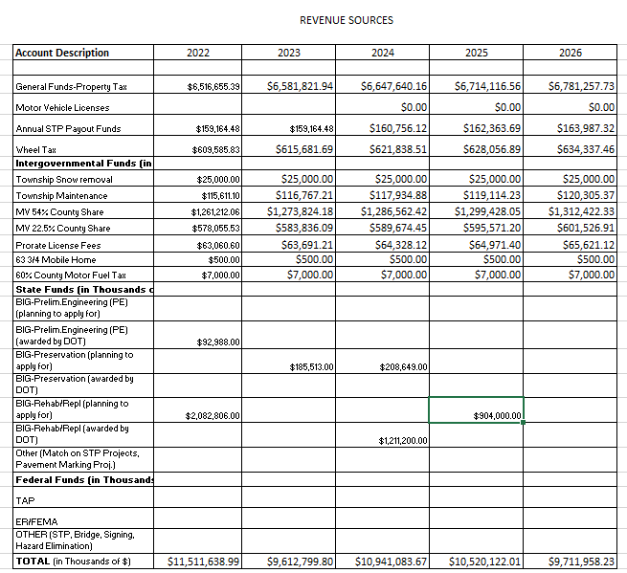

Slide 4
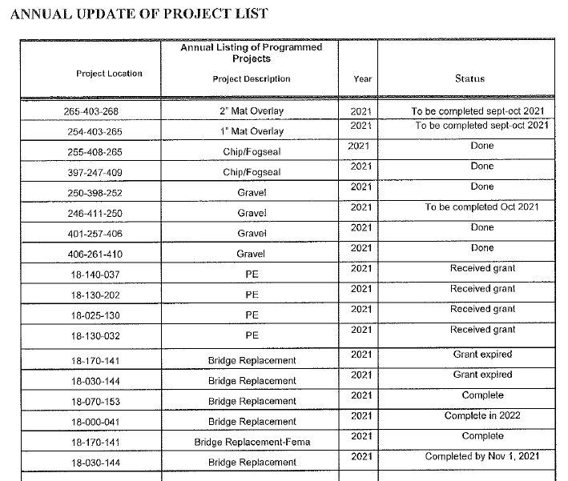

Slide 5
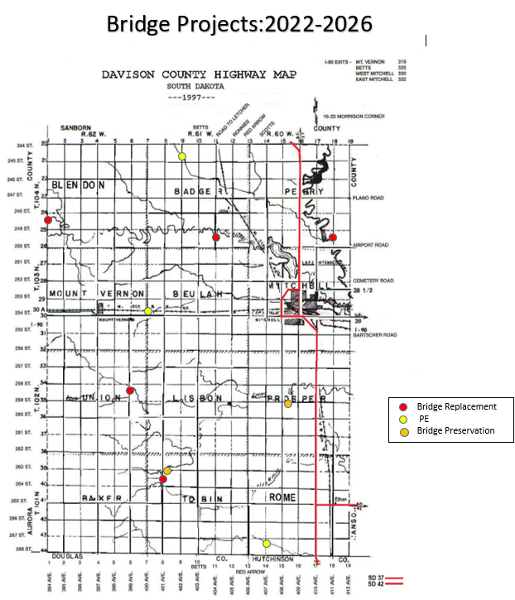
Bridge Replacements:
18-170-053: 411th Ave between 249-250th Street
18-000-041: 394th Ave between 248-249th Street
18-100-052: 404th Ave between 249-250th Street
18-050-143: 399th Ave between 258-259th Street
18-070-198: 401st Ave between 263-264th Street
Bridge Preliminary Engineering:
18-060-095: 400th Ave between 253-254th Street
18-080-077: 402nd Ave between 244-245th Street
18-130-183: 407th Ave between 264-265th Street
Bridge Preservation:
18-072-190: 263rd Street between 401-402nd Ave
18-142-150: 259th Street between 408-409th Ave

Slide 6
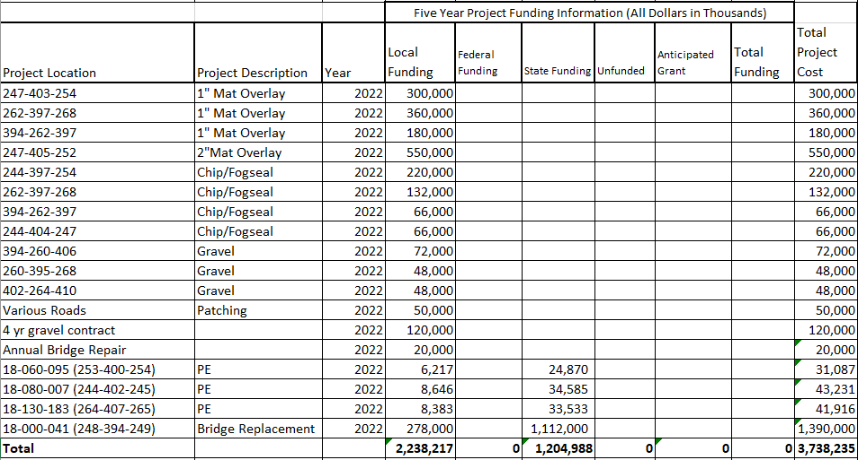

Slide 7
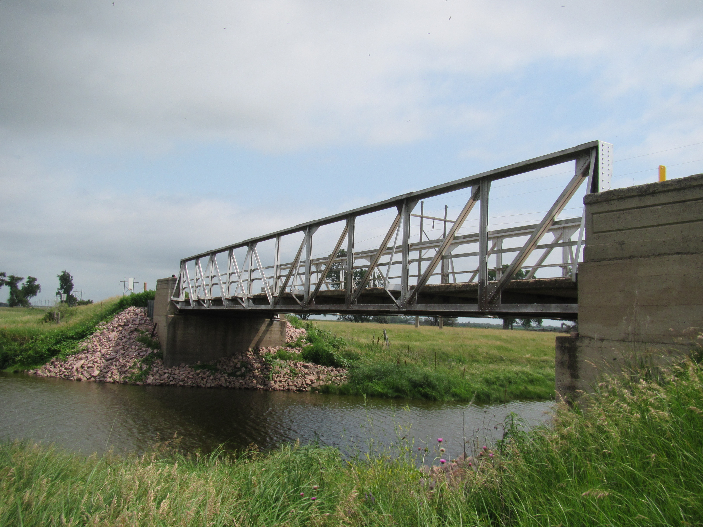
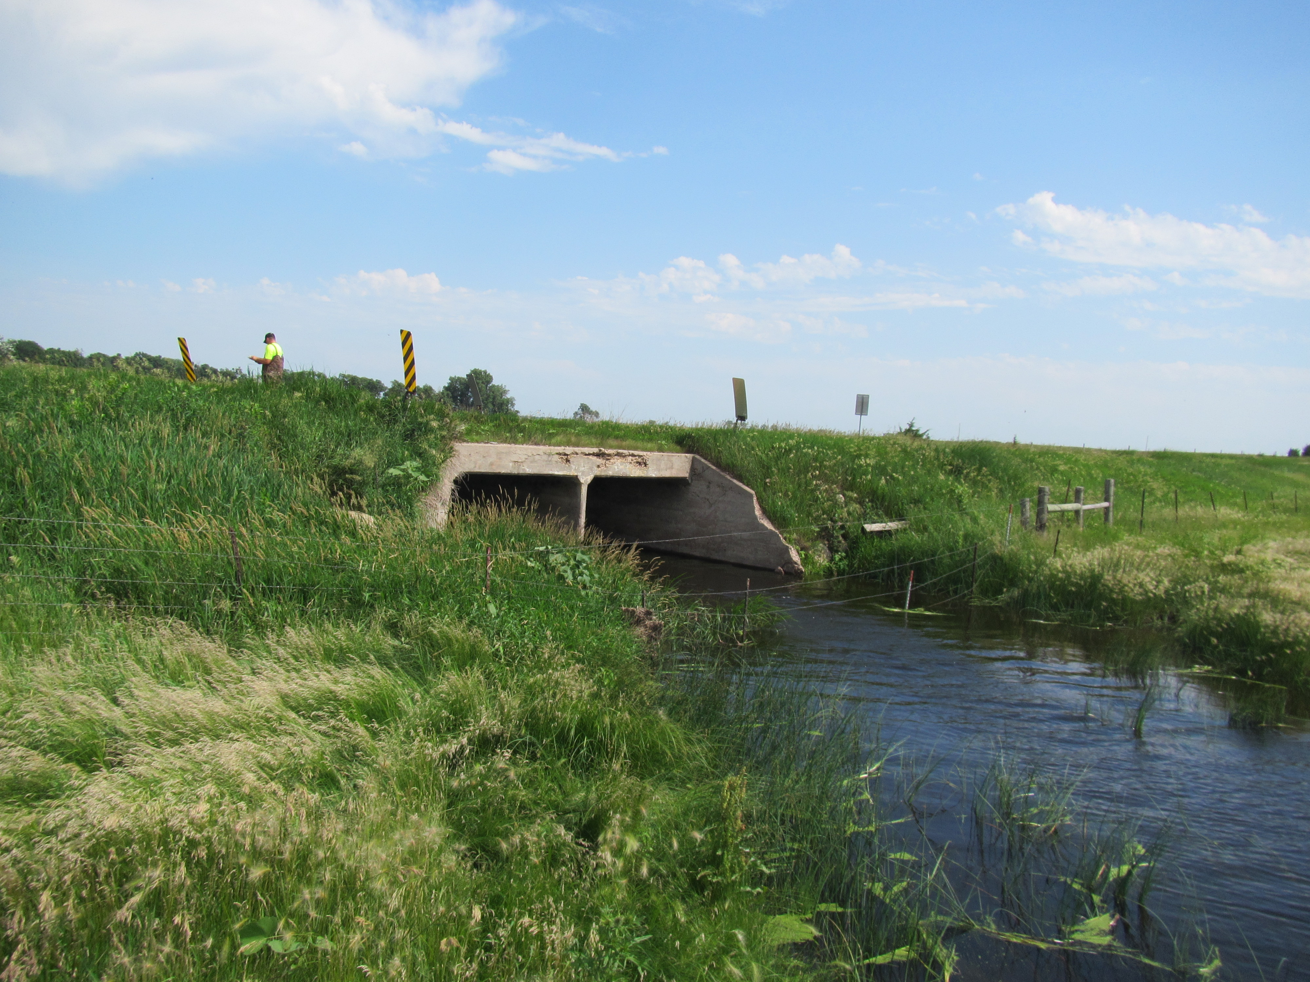
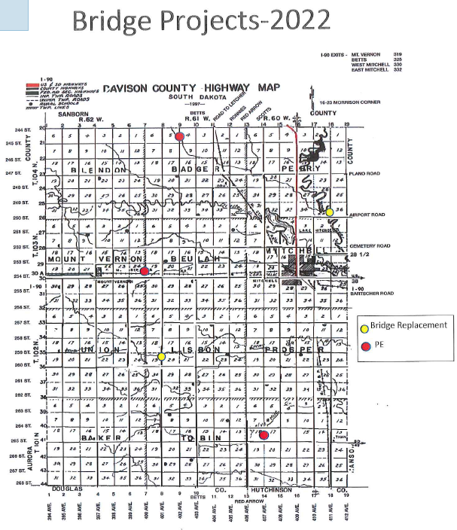
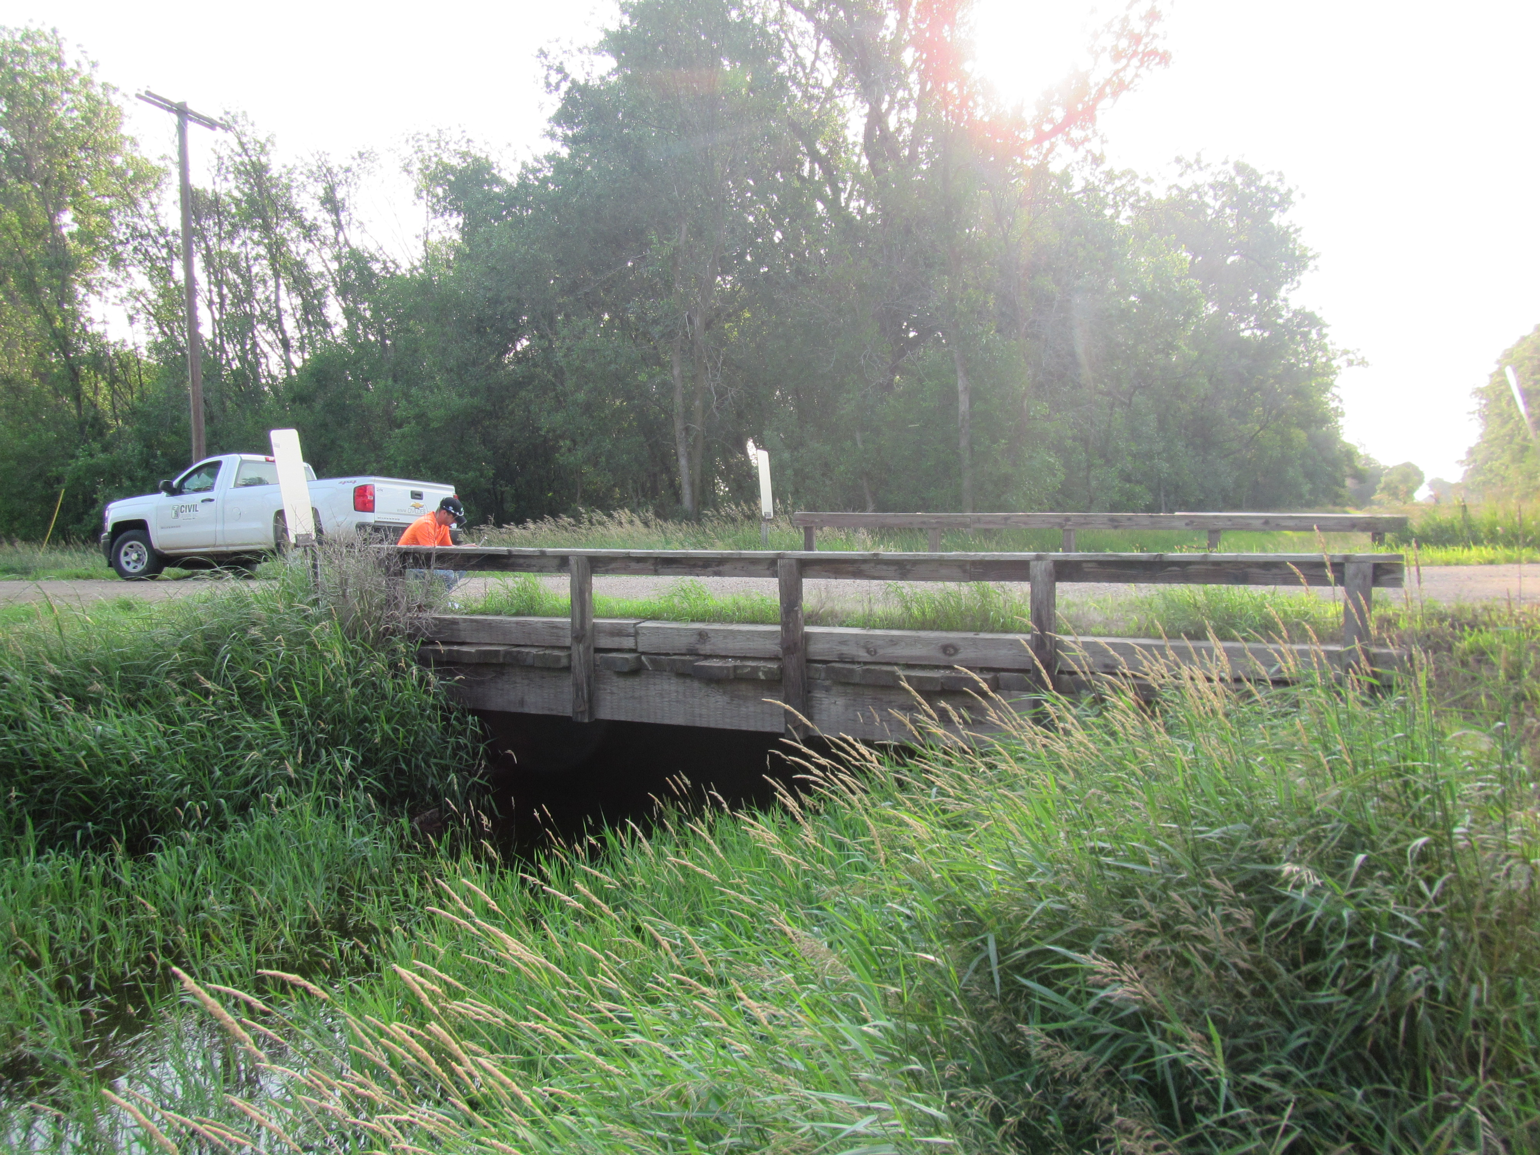
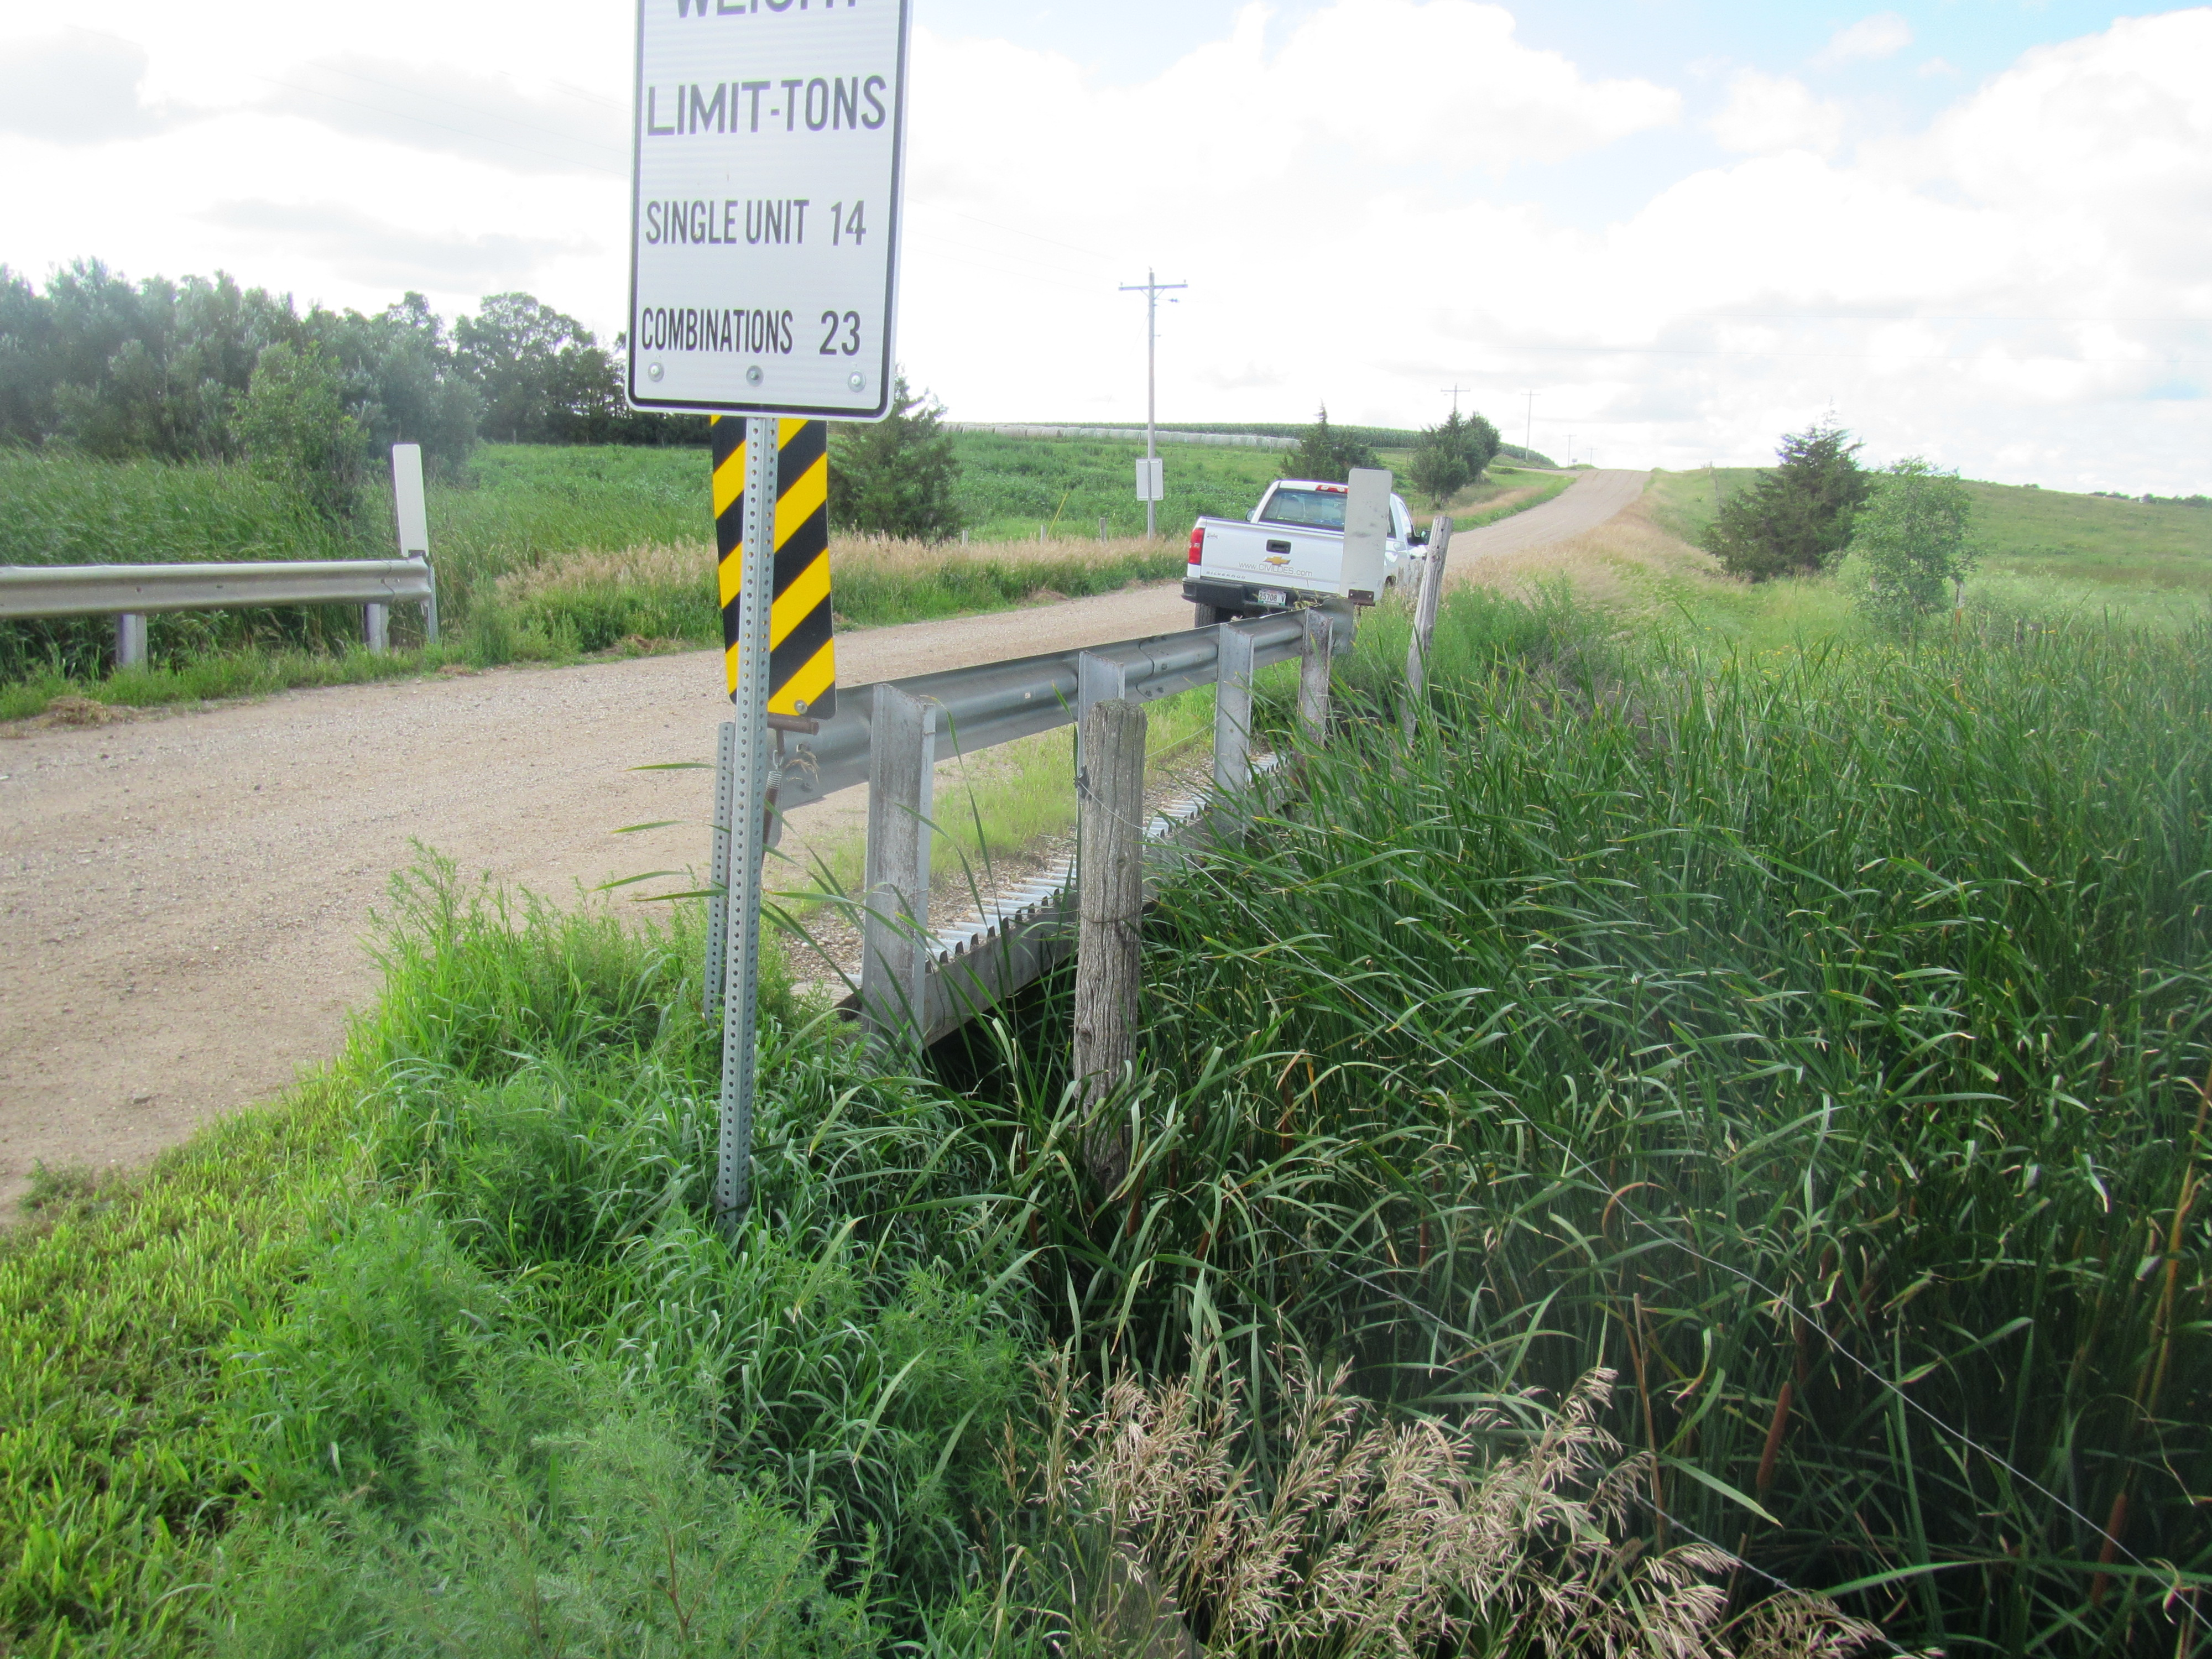
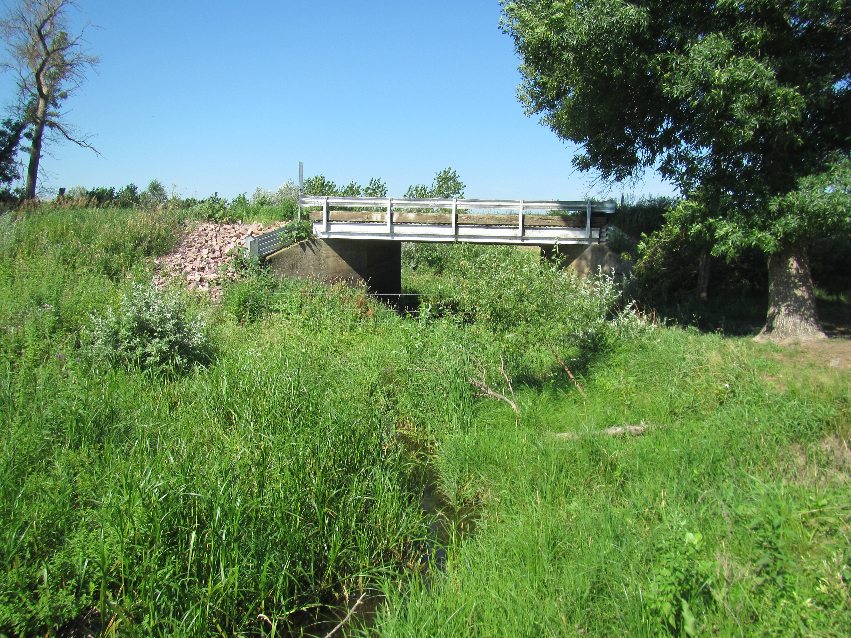
Replacement: 394th Ave b/t 248-249th St
PE: 402nd Ave b/t 244-245th St
PE: 400th Ave b/t 253-254th St
PE: 407th Ave b/t 264-265th St
Replacement: 411th Ave b/t 249-250th St

Slide 8
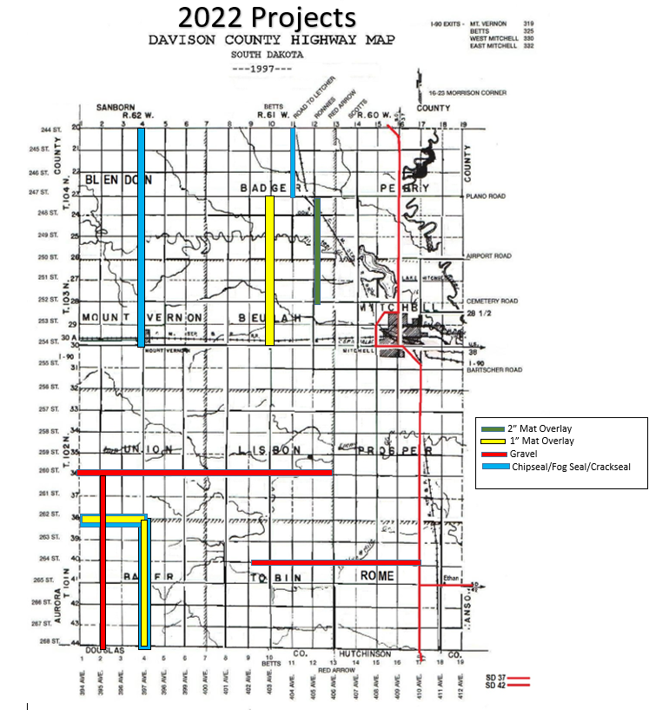
Mat Overlay:
1” overlay: 403rd Ave b/t 247-254 (7 miles)
1” overlay: 397th Ave b/t 262-268 (6 miles)
1” overlay: 262nd St b/t 394-397 (3 miles)
2” overlay: 405th Ave b/t 247-252 (5 miles)
Total miles = 21
Chipseal/Fog seal:
397th Ave b/t 244-254th St (10 miles)
397th Ave b/t 262-268th St (6 miles)
262nd St b/t 394-397th Ave (3 miles)
404th Ave b/t 244-247th St (3 miles)
Total miles = 22
Gravel:
260th St b/t 394-406th Ave (12 miles)
395th Ave b/t 260-268 St (8 miles)
264th St b/t 402-410 Ave (8 miles)
Total miles = 28

Slide 9
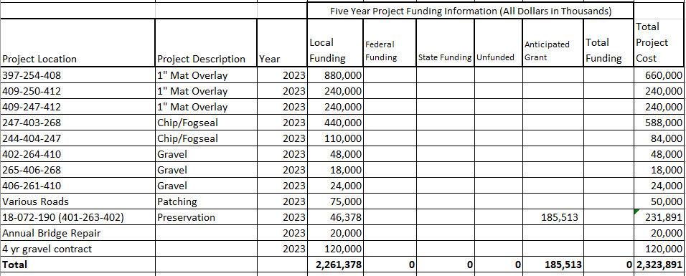

Slide 10
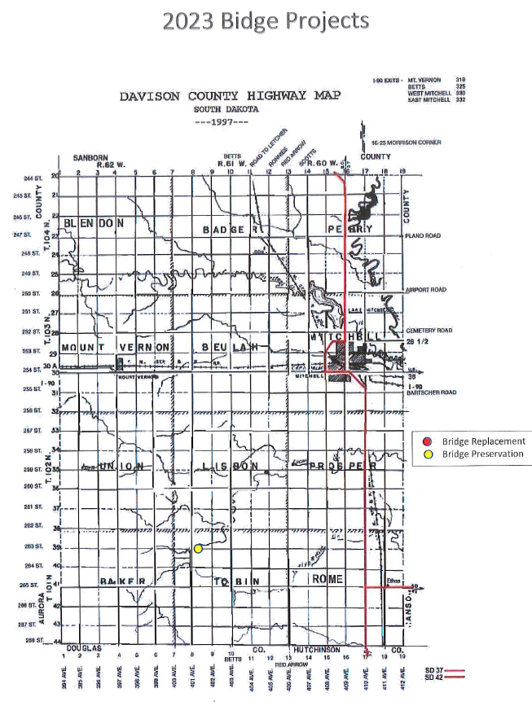
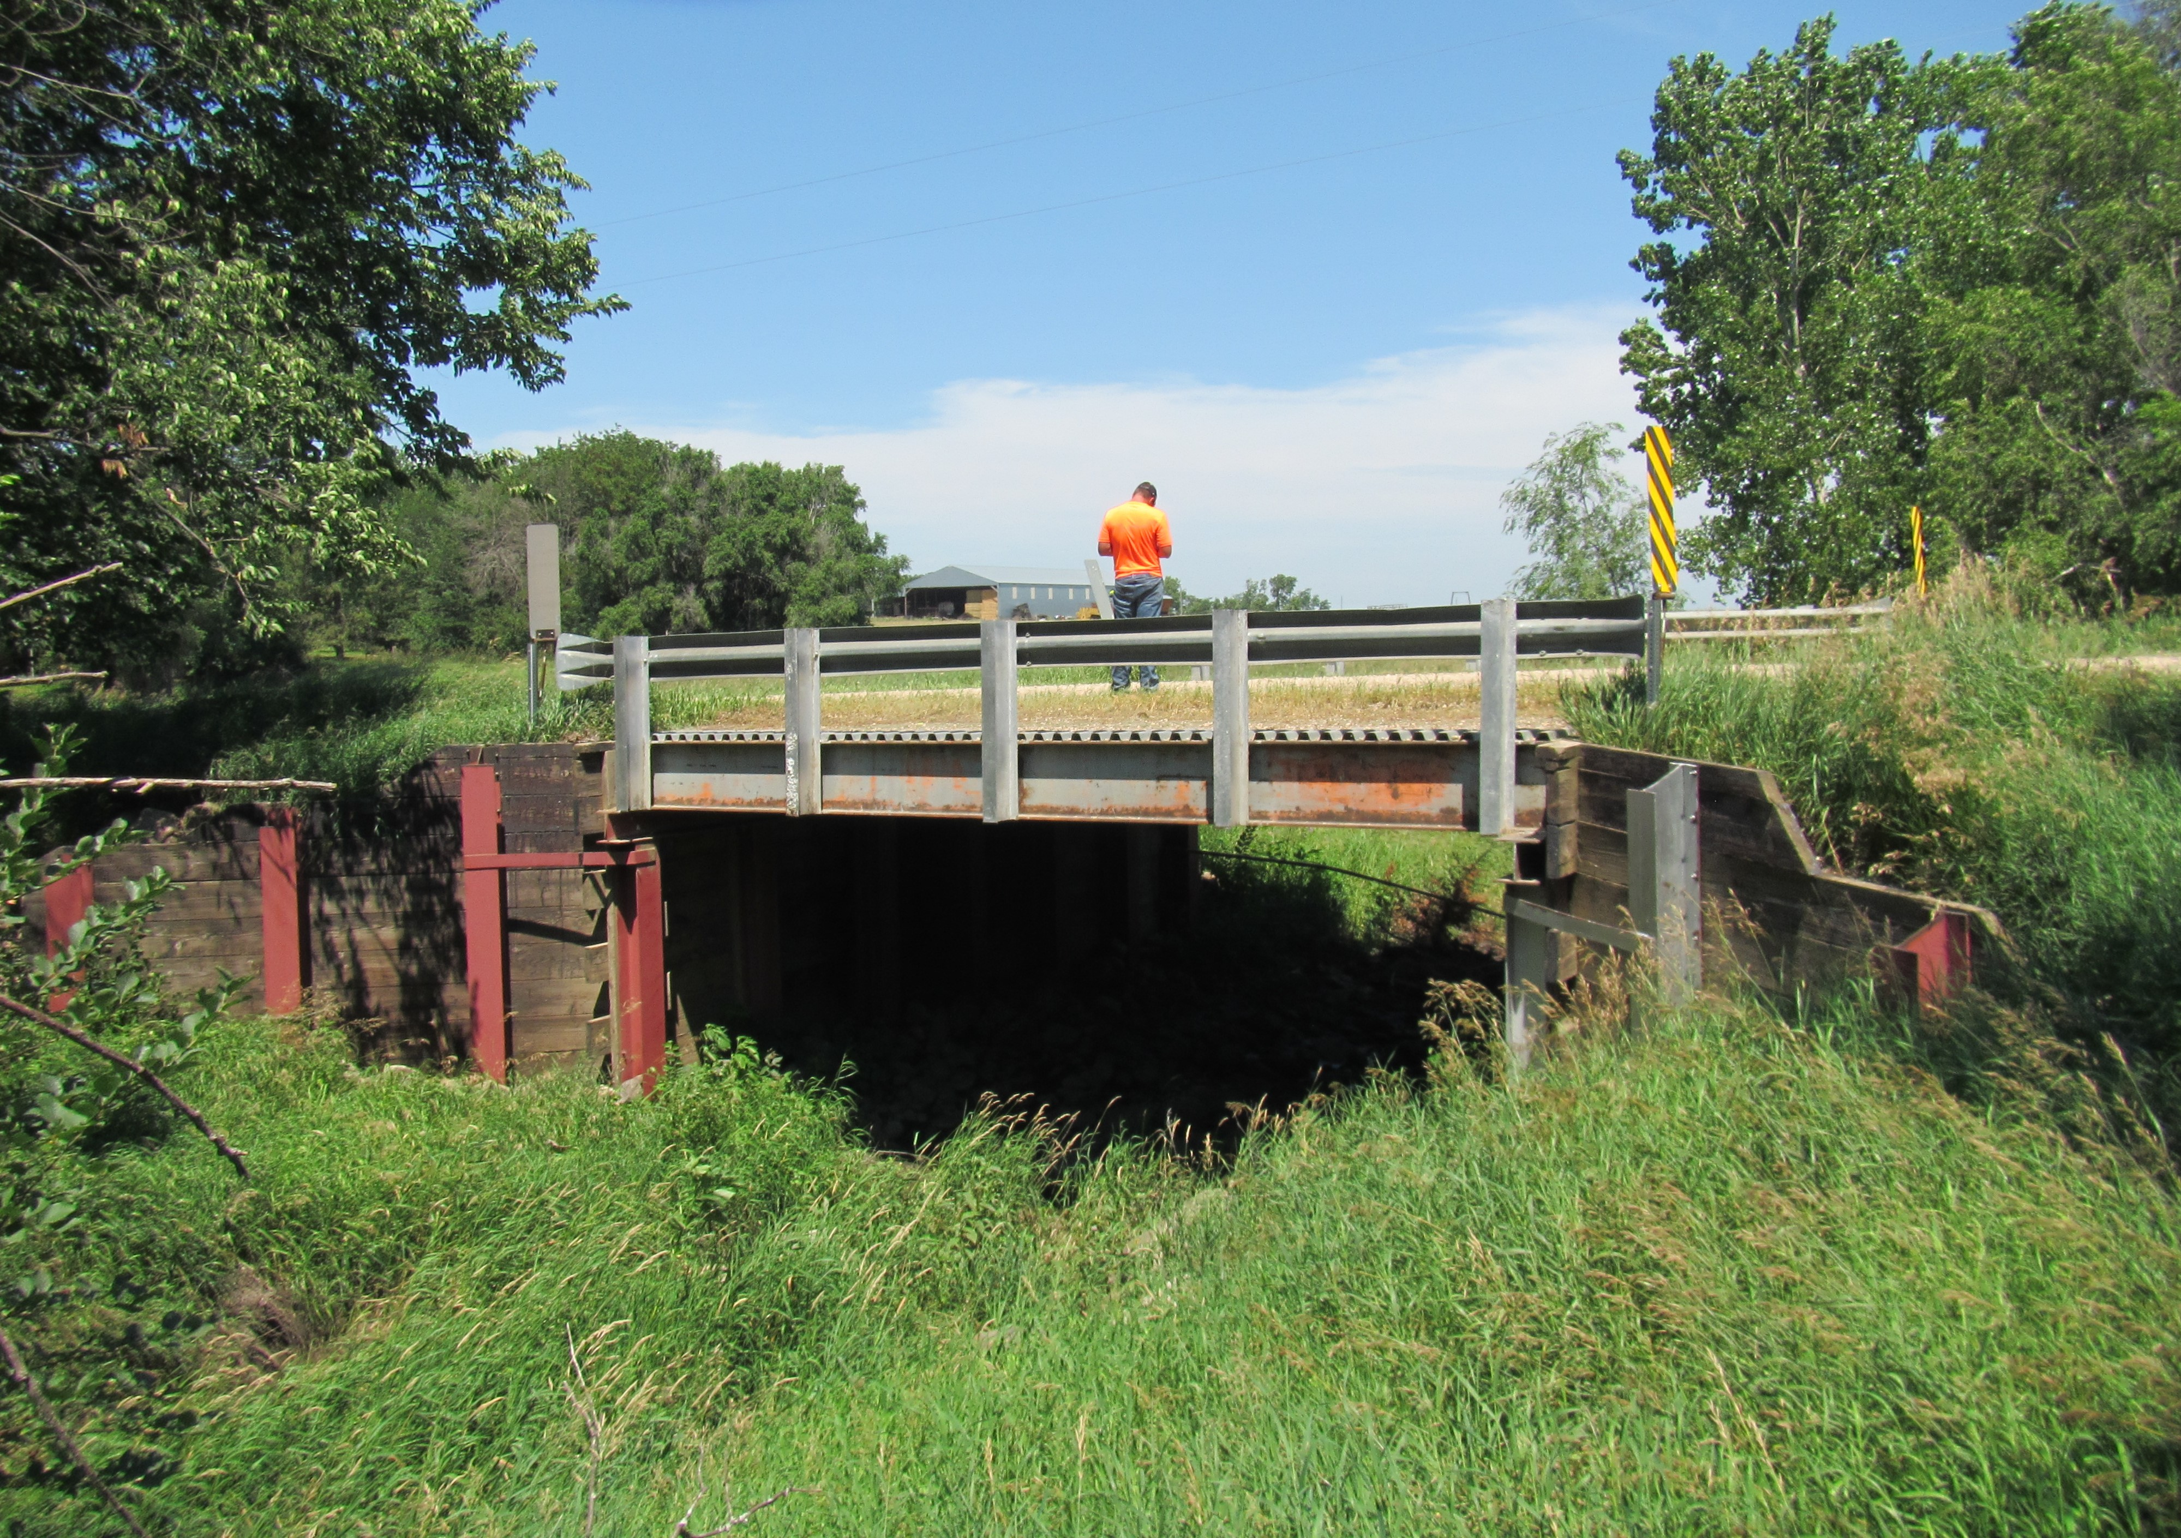
Preservation: 263rd St b/t 401-402nd Ave

Slide 11
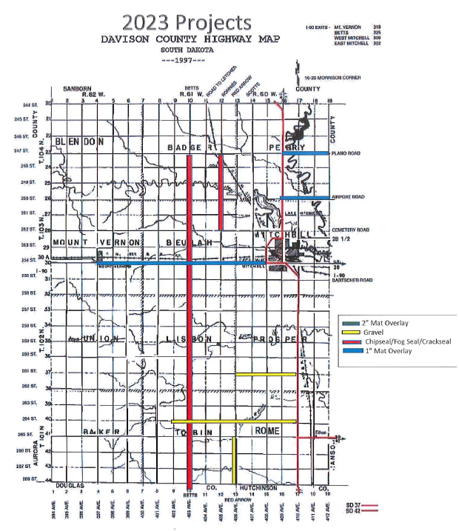
Mat Overlay:
1” overlay: 254th St b/t 397-408 (11 miles)
1” overlay: 250th St b/t 409-412 (3 miles)
1” overlay: 247th St b/t 409-412 (3 miles)
Total miles = 17
Chipseal/Fog seal:
403rd Ave b/t 247-268th St (21 miles)
404th Ave b/t 244-247th St (3 miles)
Total miles = 24
Gravel:
264th St b/t 402-410th Ave (8 miles)
406th Ave b/t 265-268th St (3 miles)
261st St b/t 406-410th Ave (4 miles)
Total miles = 15

Slide 12
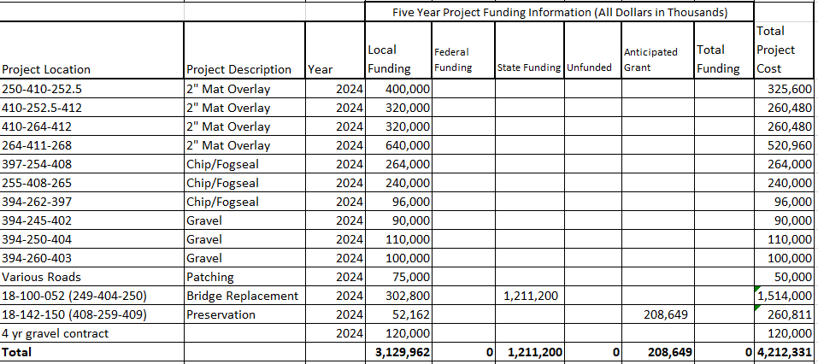

Slide 13
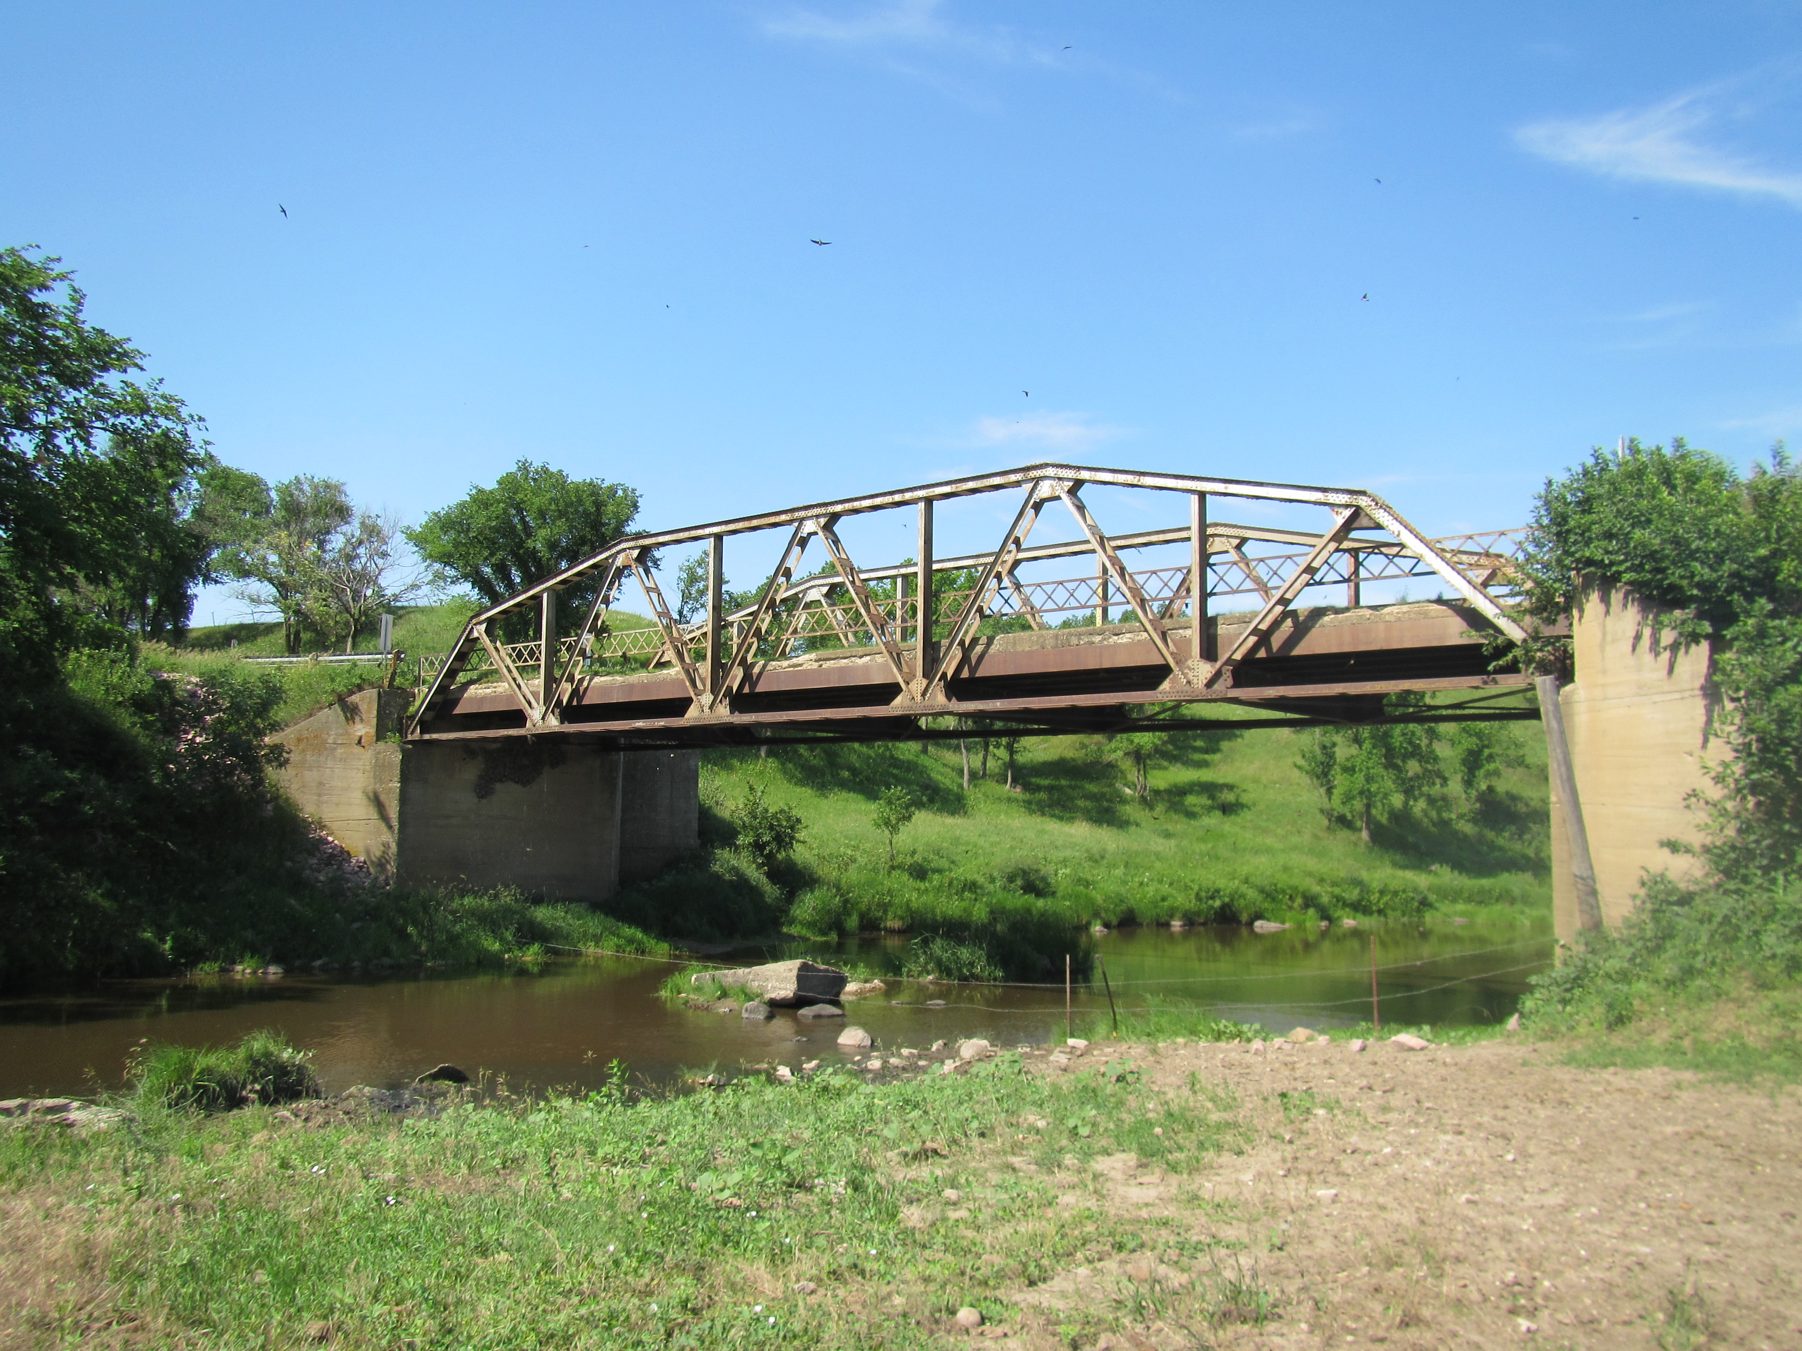
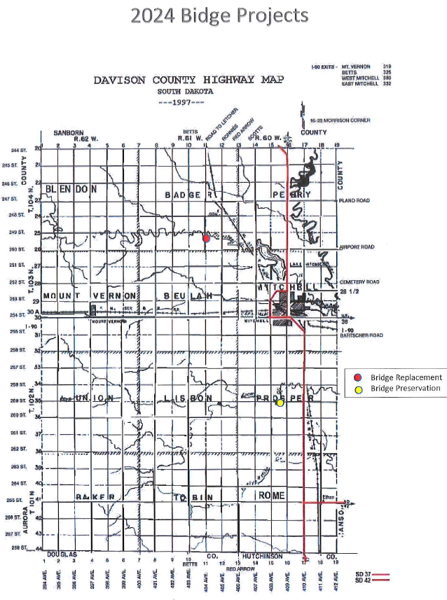
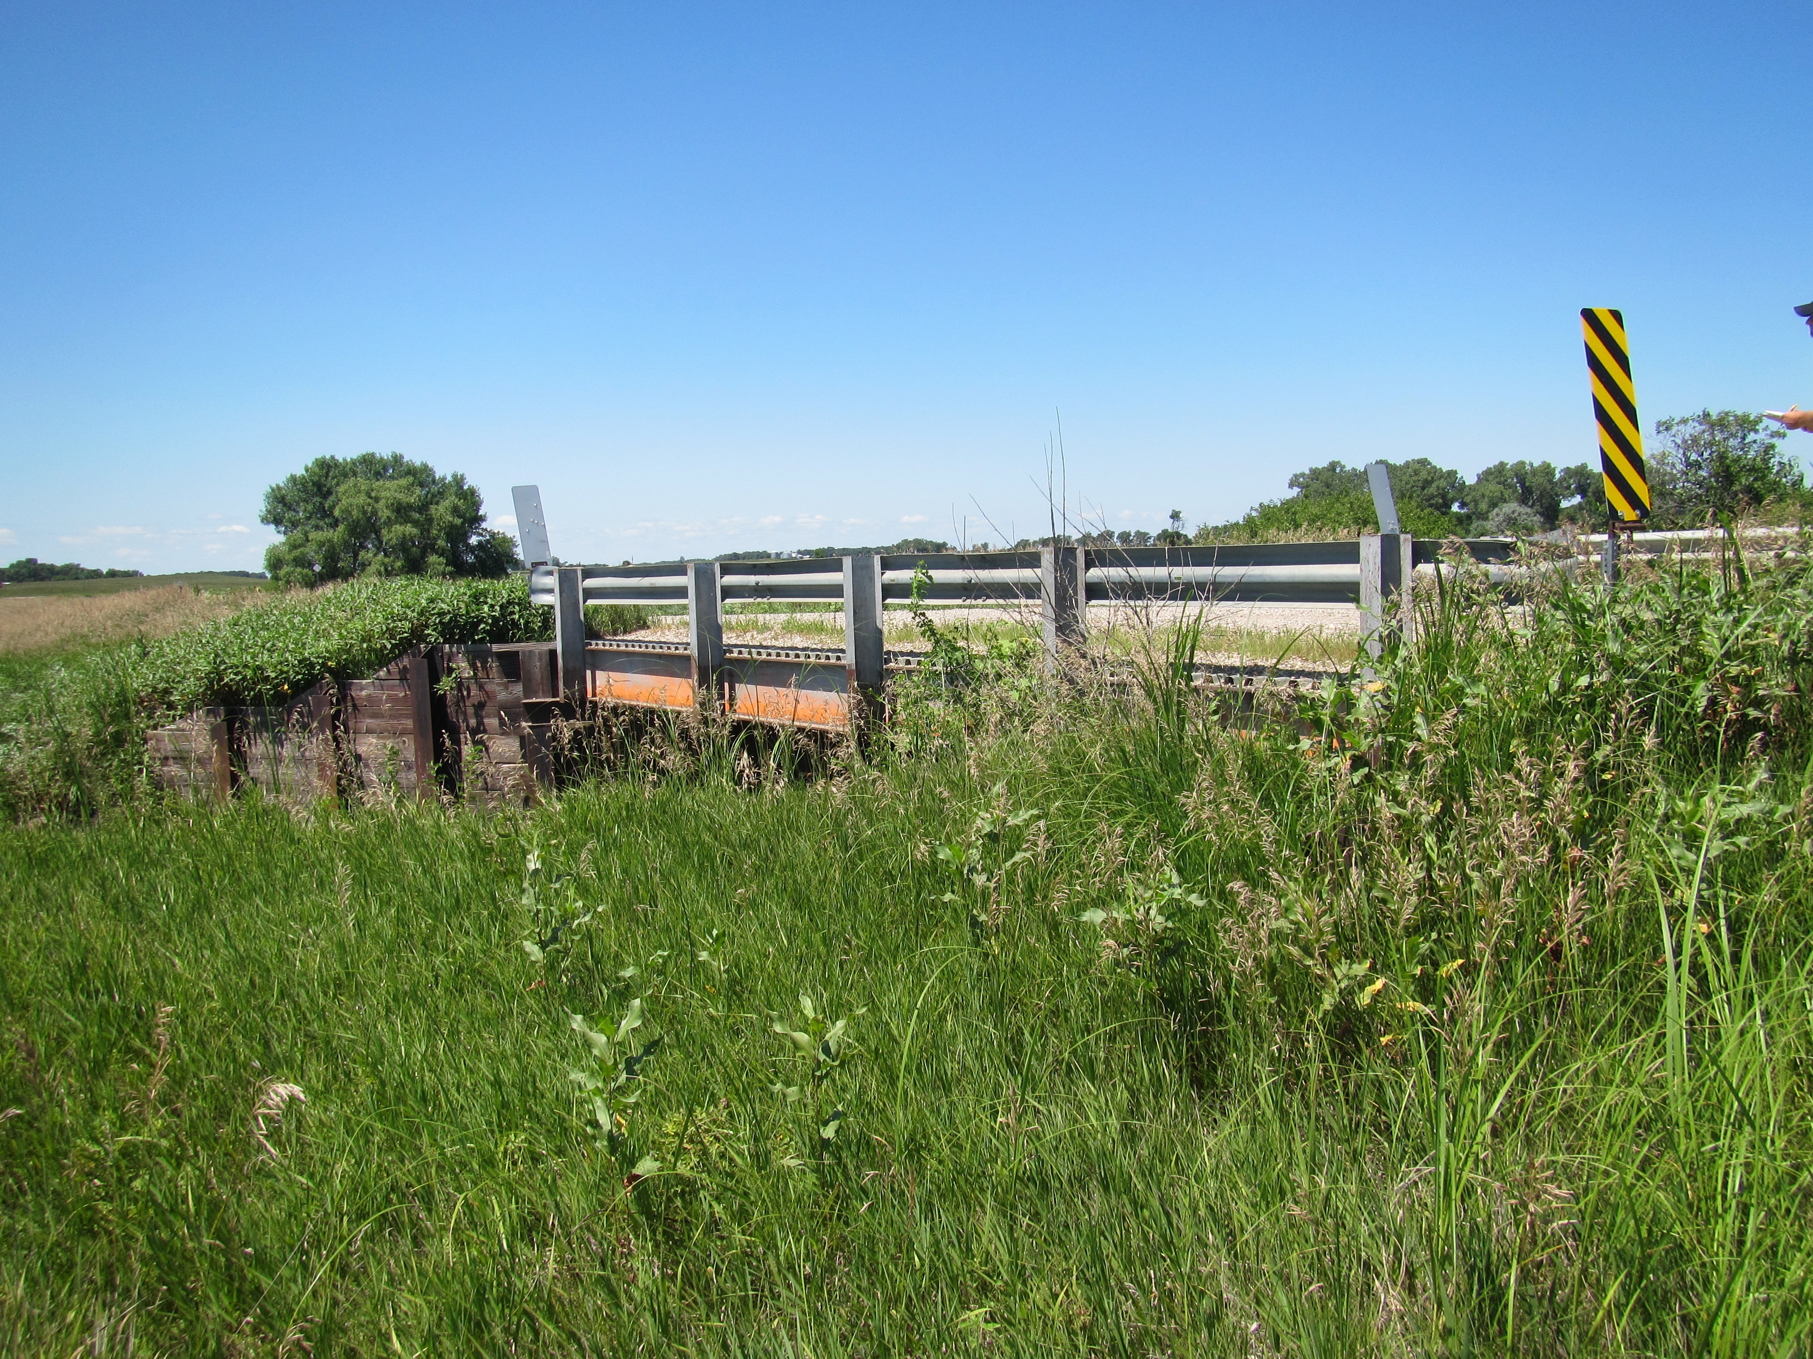
Replacement: 404th Ave b/t 249-250th St
Preservation: 259th St b/t 408-409th Ave

Slide 14
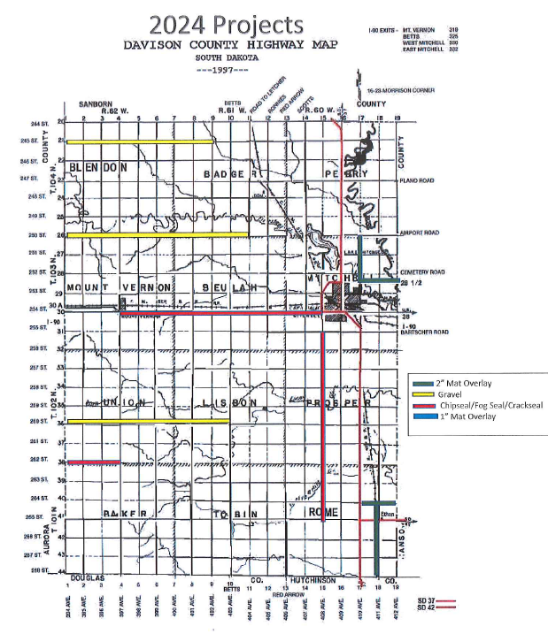
Mat Overlay:
2” overlay: 410th Ave b/t 250-252.5 (2.5 miles)
2” overlay: 252.5 St b/t 410-412 (2 miles)
2” overlay: 264th St b/t 410-412 (2 miles)
2” overlay: 411th Ave b/t 264-268 (4 miles)
Total miles = 10.5
Chipseal/Fog seal:
254th St b/t 397-408th Ave (11 miles)
408th Ave b/t 255-265th St (10 miles)
262nd St b/t 394-397th Ave (3 miles)
Total miles = 24
Gravel:
245th St b/t 394-402nd Ave (8 miles)
250th St b/t 394-404th Ave (10 miles)
260th St b/t 394-403rd Ave (9 miles)
Total miles = 27

Slide 15
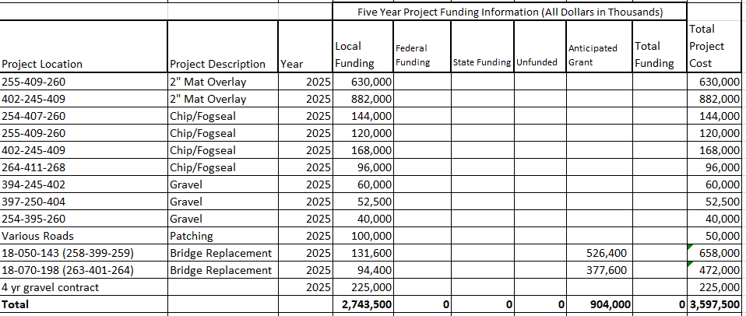

Slide 16
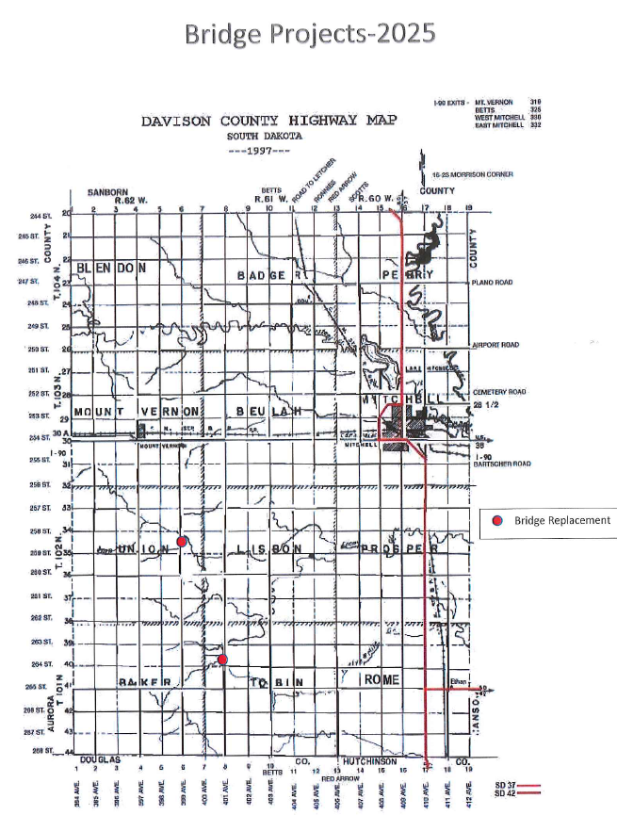
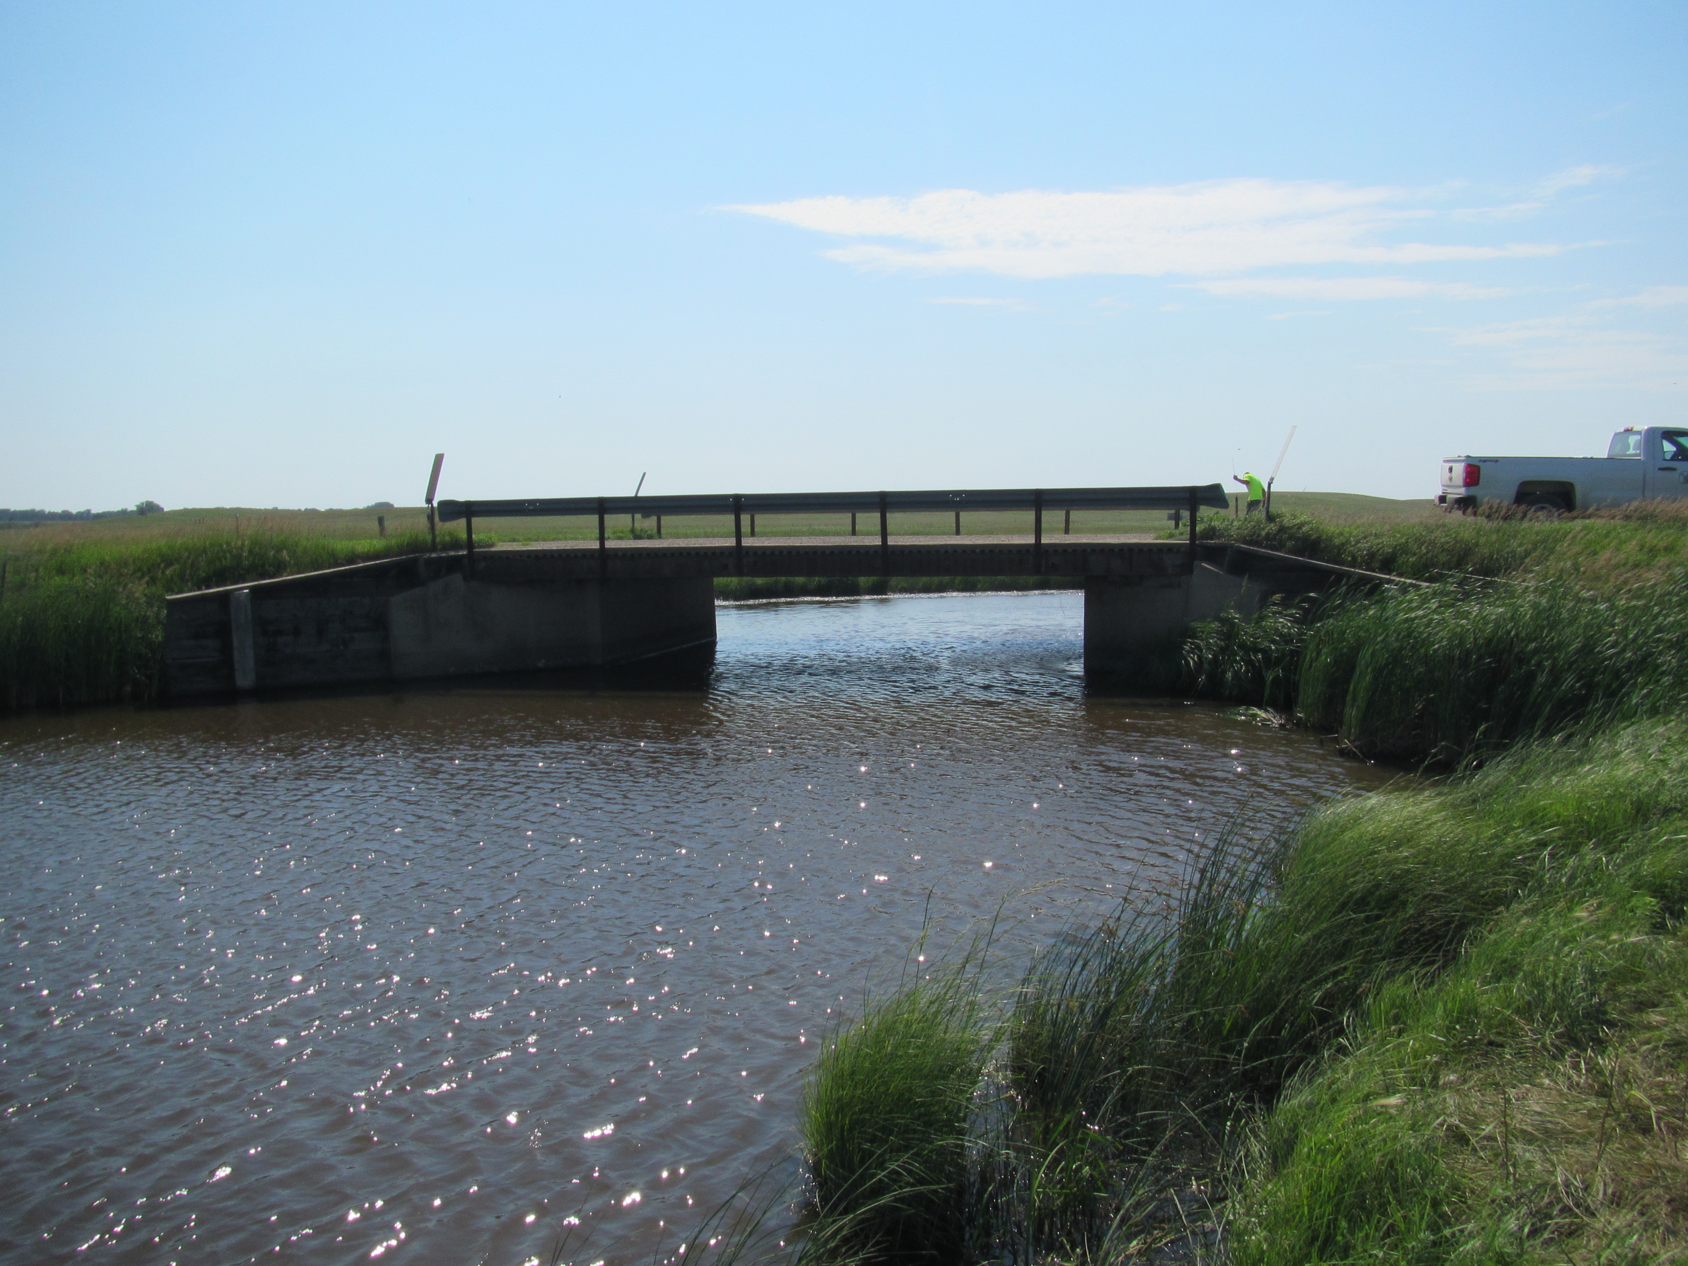
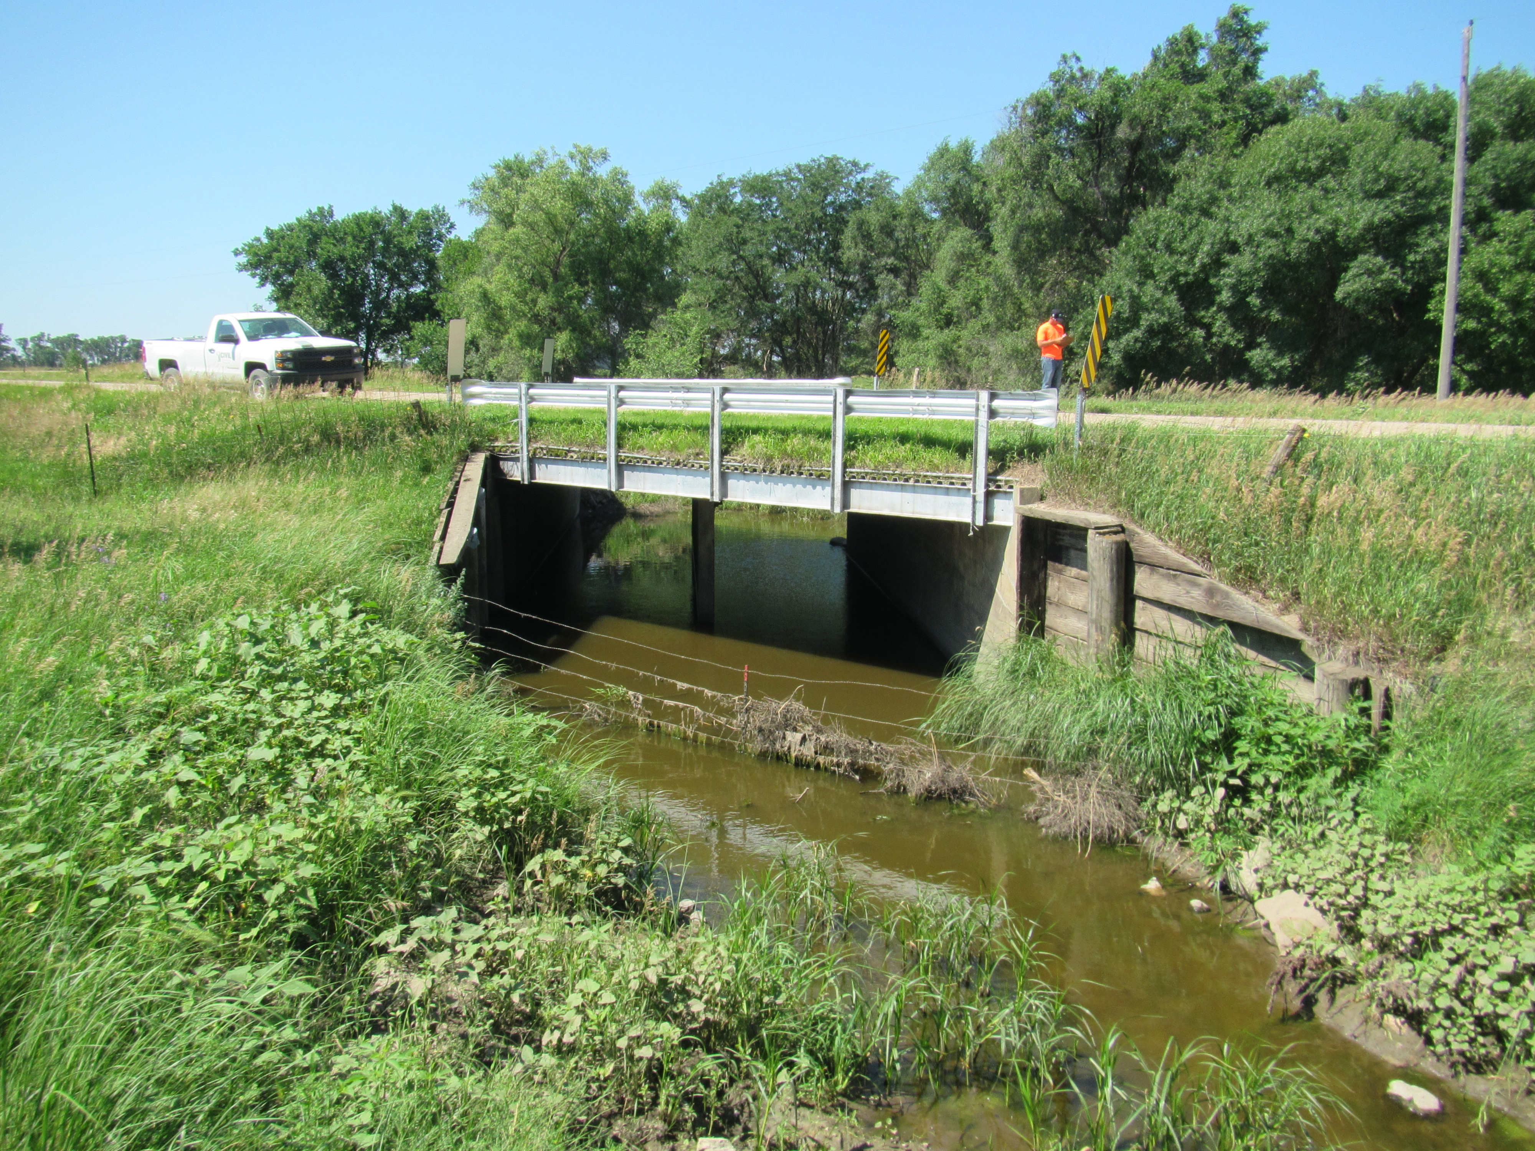
Replacement: 399th Ave b/t 258-259th St
Replacement: 401st Ave b/t 263-264th St

Slide 17
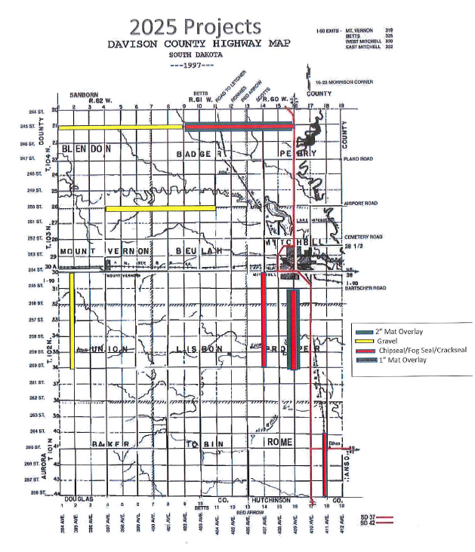
Mat Overlay:
2” overlay: 409th Ave b/t 255-260th St (5 miles)
2” overlay: 245th St b/t 402-409th Ave (7 miles)
Total miles = 12
Chipseal/Fog seal:
407th Ave b/t 254-260th St (6 miles)
409th Ave b/t 255-260th St (5 miles)
245th St b/t 402-409th Ave (7 miles)
411th Ave b/t 264-268th St (4 miles)
Total miles = 22
Gravel:
245th St b/t 394-402nd Ave (8 miles)
250th St b/t 397-404th Ave (7 miles)
395th Ave b/t 254-260th St (6 miles)
Total miles = 21

Slide 19
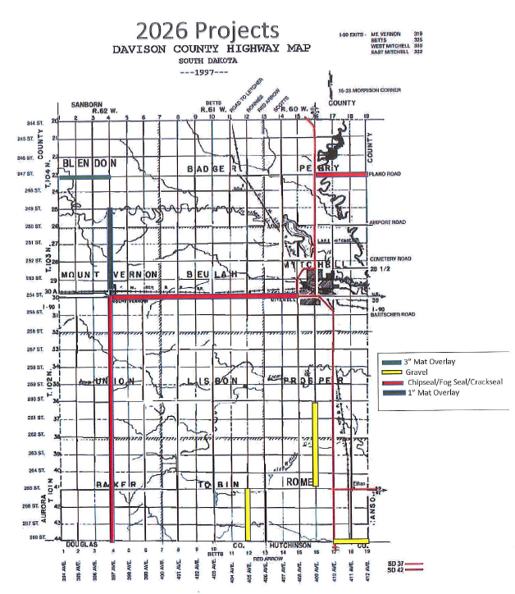
Mat Overlay:
3” overlay: 247th St b/t 394-397th Ave (3 miles)
1” overlay: 397th Ave b/t 249-253.5 (4.5 miles)
Total miles = 7.5
Chipseal/Fog seal:
397th Ave b/t 254-268th St (14 miles)
254th St b/t 397-408th Ave (11 miles)
247th St b/t 409-412 Ave (3 miles)
Total miles = 28
Gravel:
406th Ave b/t 265-268th St (3 miles)
268th St b/t 410-412th Ave (2 miles)
409th Ave b/t 260-265th St (5 miles)
Total miles = 10

